Slide 1

Combining Recent Advances in Reinforcement Learning
FOR
Max Woolterton, department of natural sciences, durham university
Notes:
Hello I am Max Woolterton, I am a natural scientist at durham university, undertaking a third year project within the department of computer science.
Today I am going to be giving an overview of the context, background and motivation of the project, along with the projects goals and deliverables, and how they will be evaluated.
My project title Is Machine Learning for Game Playing. Specifically, I am investigating the design and creation of an intelligent agent capable of teaching itself to play the game Super Mario Bros, at varying levels of increasing difficulty.

Slide 2
Combining Recent Advances in Reinforcement Learning
Max Woolterton, department of natural sciences, durham university
Notes:
Hello I am Max Woolterton, I am a natural scientist at durham university, undertaking a third year project within the department of computer science.
Today I am going to be giving an overview of the context, background and motivation of the project, followed by a demonstration and evaluation of the project and what was achieved.
My project title Is Combining Recent Advances in Reinforcement Learning. Specifically, I am investigating the design and creation of an intelligent agent capable of teaching itself to play the game Super Mario Bros, at varying levels of increasing difficulty. This is achieved via the combination of many recent state-of-the-art contributions to the field of Reinforcement Learning.

Slide 3
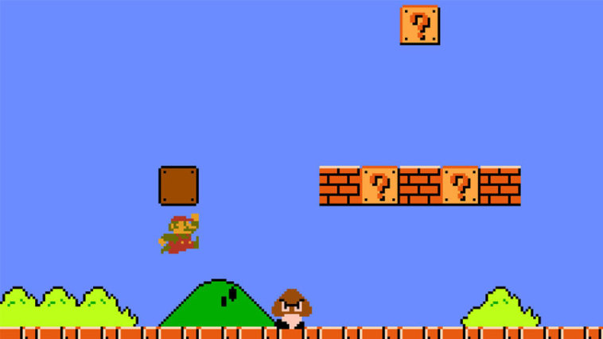
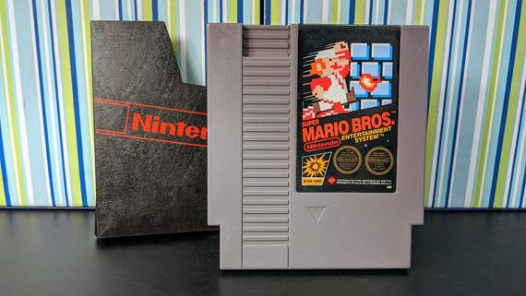
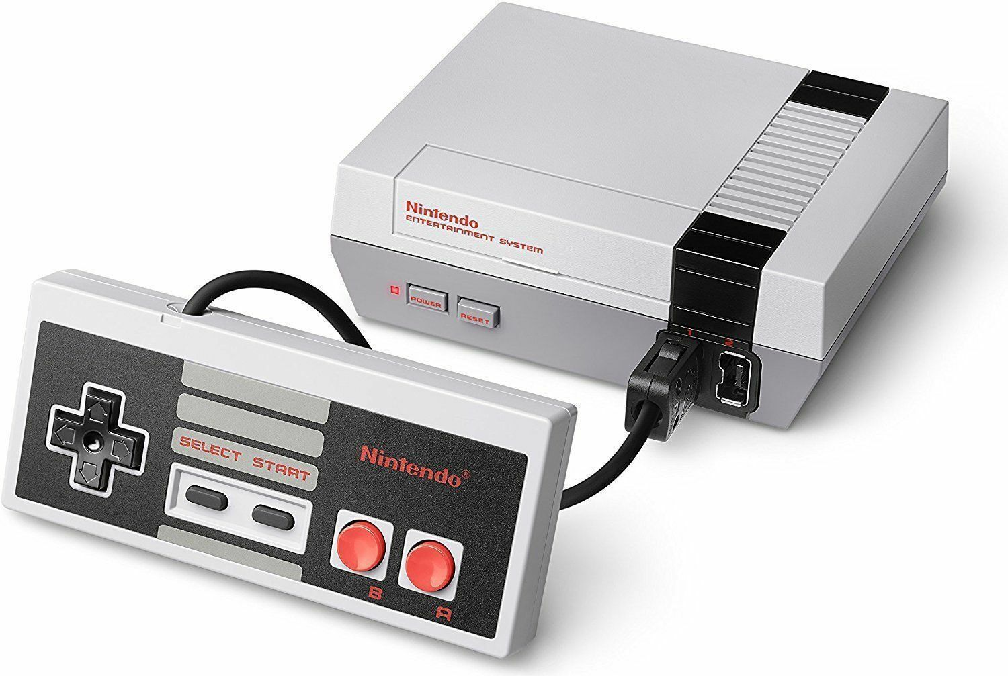
super Mario Bros.
Notes:
Super mario bros was a game released by nintendo in 1985 for the nintendo entertainment system, which can be seen in the middle image. Super mario bros is a platformer, which is a genre of game where the aim is to navigate through and reach the end of a level consisting of obstacles, traps and enemies without dying. Mario himself can be seen on the left, and below and to the right of him an example of an enemy can be seen, specifically a goomba.
A players skill is predominantly determined by their ability to complete difficult levels along with how fast they can do so.
Every in-game frame, once the agent has decided which action it would like to take, for example running, jumping or standing still, the respective inputs are passed to an emulator, which is emulating super mario bros using Python and C in real-time.

Slide 4
super Mario Bros.
Kauten (2018) [30]
Notes:
Super mario bros was a game released by nintendo in 1985 for the nintendo entertainment system, which can be seen in the middle image. Super mario bros is a platformer, which is a genre of game where the aim is to navigate through and reach the end of a level consisting of obstacles, traps and enemies without dying. Mario himself can be seen on the left, and below and to the right of him an example of an enemy can be seen, specifically a goomba.
A players skill is predominantly determined by their ability to complete difficult levels along with how fast they can do so.
Every in-game frame, once the agent has decided which action it would like to take, for example running, jumping or standing still, the respective inputs are passed to an emulator, which is emulating super mario bros using Python and C in real-time.

Slide 5
The Goal
> To design and create an intelligent machine learning agent capable of completing multiple levels of Super Mario Bros of increasing difficulty simultaneously.
> To investigate the effects of combining some of the latest state-of-the-art (SOTA) Reinforcement Learning (RL) techniques and algorithms into a single agent.
> To develop and display an understanding of the resultant agent and its ability to learn, by breaking down its performance into that provided by each of its constituent components.
Notes:
The goal of this project is to design and create an intelligent agent using machine learning which, when trained on a training set consisting of multiple levels, is capable of consistently completing the majority of them.
To do so we will be attempting to combine some of the latest state of the art techniques and algorithms from reinforcement learning into a single agent. Simultaneously, we will be trying to work out how best to combine these components, as not all algorithms are compatible nor are their benefits necessarily orthogonal.
After this agent has been made, the final task in the project is to analyze the agent and its ability to learn, by breaking down its performance into that provided by each of its constituent parts via extensive ablation studies.

Slide 6
Reinforcement Learning:
I want to get as much reward as possible!
AGENT
ENVIRONMENT
Action
Reward
Notes:
For reference, Reinforcement Learning, inspired by behaviorist psychology, is one of the three main fundamental machine learning paradigms, wherein agents are trained to behave optimally with respect to a given reward signal, in other words to optimize their actions in order to maximize the reward obtained over time.

Slide 7
Q-Learning:
How do I select the best action...?
AGENT
ENVIRONMENT
Action
Reward
Notes:
Q-learning is a reinforcement learning algorithm that enables an agent to learn a behavior policy to act by in an attempt to receive the most reward overtime.
You may be wondering how exactly the agent knows how to act “optimally”.

Slide 8
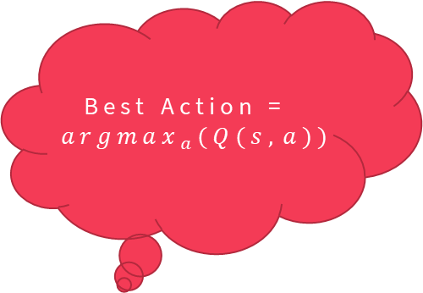
Q-Learning:
Where $Q\left(s,a\right)$ is the value estimate of taking action $a$ from state $s$
Best Action = ${argmax}_{a}(Q(s,a))$
AGENT
ENVIRONMENT
Action
Reward
Notes:
Well, in q-learning, every state action pair s a is given an estimate of the total value over time of taking action a from state s.
This is called a q-value.
To select the “best” action, the agent looks at all the Qvalues associated with the state it is currently in, and selects the action with the maximum q-value. It then passes this action to the environment to receive a reward back, for this exact process to then repeat over and over again until the agent either completes the level or dies.

Slide 9







Q-Learning:
Where $Q\left(s,a\right)$ is the value estimate of taking action $a$ from state $s$
Timestep $t$
Reward $r_{t}$, action $a_{t}$, state $s_{t}$
Best Action = ${argmax}_{a}(Q(s,a))$
Discount factor $γ∈[0,1)$
Future discounted reward $G_{t}=\sum_{k=0}^{∞}{γ^{k}r_{t+k}}$ from timestep $t$
Optimal behavior policy $π^{∗}$
$Q\left(s,a\right)$is an estimate of $Q^{∗}\left(s,a\right)=𝔼\left[G_{t} | s_{t}=s,a_{t}=a,π^{∗}\right]$,
when following optimal policy $π^{∗}$ from timestep $t$ onwards
AGENT
In traditional tabular Q-Learning, every state-action pair has its own entry $Q(s,a)$ in a large Q-table.
These entries are updated using the Bellman equation as an iterative update on individual transitions of experience $(s,a,r,s’)$, with learning rate $α∈(0,1]$:
$Q_{i+1}\left(s,a\right)←Q_{i}\left(s,a\right)+α\left((r+γ\max_{a^{′}}{Q_{i}}\left(s^{′},a^{′}\right))−Q_{i}\left(s,a\right)\right)$
As $i→∞,$ $Q_{i}→Q^{∗}$
Notes:
In traditional tabular Q learning, every state action pair has its own entry in a large QTable.
Every time the agent performs an action this QTable can then be updated using a relation known as the bellman equation.
By some complex mathematics, as the number of updates tends to infinity, following the policy of always taking the best action from this qtable becomes optimal.
If you want to know more about the formal maths behind Q-Learning, in the red box at the top, you can see the formal notation for everything I have just set out in words.

Slide 10



Deep Q-Learning:
DQN (2013) [13]
In Deep Q-Learning, a parameterized value function approximator $Q(s,a;θ)$is instead used to estimate $Q^{∗},$specifically a multi-layered neural network with parameters $θ$.
This network is called a Deep Q-Network (DQN) [13] replacing the Q-tables above.
This network is then trained and its parameters updated via stochastic gradient descent to minimize the following loss:
Best Action = ${argmax}_{a}(Q(s,a))$
AGENT
$${\left(\left(r_{t}+γ\max_{a^{′}}{Q}\left(s_{t+1},a^{′};θ_{i}\right)\right)−Q\left(s_{t},a_{t};θ_{i}\right)\right)}^{2}$$
, with the transition $(s_{t},a_{t},r_{t},s_{t+1})$ now being sampled from an Experience Replay buffer [16] containing the last $N (={10}^{6})$ transitions to reduce correlation between subsequent samples.
Notes:
In deep Q-Learning, this Q-table is instead replaced by a parameterized value function approximator, namely a neural network, which is then used to approximate the "optimal" table Q*.
This is called a deep Q-network, or a DQN.
This network is then trained via stochastic gradient descent using a loss derived from the same bellman equation as the iterative update in traditional Q-learning.
Do you have any questions at this point?

Slide 11


Deep Q-Learning:
DQN (2013) [13]
In Deep Q-Learning, a parameterized value function approximator $Q(s,a;θ)$is instead used to estimate $Q^{∗},$specifically a multi-layered neural network with parameters $θ$.
This network is called a Deep Q-Network (DQN) [13] replacing the Q-tables above.
This network is then trained and its parameters updated via stochastic gradient descent to minimize the following loss:
A more stable target! No more catastrophic forgetting for me!
AGENT
$${\left(\left(r_{t}+γ\max_{a^{′}}{Q}\left(s_{t+1},a^{′};θ_{i}^{−}\right)\right)−Q\left(s_{t},a_{t};θ_{i}\right)\right)}^{2}$$
, with $Q\left(s_{t+1},a^{′};θ_{i}^{−}\right)$ representing the target network, an identical copy of the online network $Q\left(s_{t},a_{t};θ_{i}\right)$, except its weights $θ^{−}$are only copied over from the online network every$τ$updates and kept constant in between.
Notes:
In order to provide a stable target to train against, mnih et al introduced the concept of a target network, which is an identical copy to the online network, except its weights \theta^- are only copied over from the online network every \tau updates and kept constant in between, with gradients only being back propagated into the online network. This avoids the catastrophic forgetting effect and dramatically improve the performance of the DQN algorithm with this very simple change.

Slide 12
Previous Attempts at AI in Super Mario Bros.
Inverse Reinforcement Learning
Q-Learning
[1][2][7][10]
[8]
Reinforcement Learning
Hierarchical Reinforcement Learning
Other non Machine-Learning-based algorithms e.g. A* search, pre-set rule-based agents…
[11][12]
[6][9]
[3][4][5]
Genetic Algorithm
Imitation Learning
[6][7]
[9]
Notes:
When originally surveying the field to determine how best to tackle our problem we discovered that there have been many approaches applied in the past to designing an intelligent agent capable of playing Super Mario Bros, each to their own varying level of success.
The vast majority of approaches have revolved around Reinforcement Learning, more specifically Q-Learning. However, because most of these approaches were before the birth of Deep Reinforcement Learning, predominantly brought about by Mnih et al.’s DQN algorithm in 2013, they almost exclusively use traditional tabular Q-Learning, where every state has its associated value stored in a Q-table, with no generalization across similar states. This means these approaches are extremely hindered by the curse of dimensionality within the state-space, and are thus forced to apply expert feature engineering to design a low-dimensional state-encoding by abstracting and stripping away important information from the agent to make its learning tractable. The exact design of this state-encoding is predominantly what determines the relative success or failure of these approaches.
When instead using Deep Reinforcement Learning, the Generalization Power of Neural Networks can instead be leveraged so that raw-image-data can be used as the input state, taking away the choke-point of previous approaches and removing the need to decide which valuable information to strip away.
There were two previous papers that attempted to apply Deep Reinforcement Learning, however they did not incorporate any of the state of the art findings since van hasselt’s DDQN algorithm from 2015.

Slide 13
Our SOLUTION
Notes:
This is additionally what sets apart this project from all of the other approaches, as there are six years worth of state of the art research that have yet to be applied to this field.

Slide 14
Double Q (2010) [14]
Q Learning (1992) [29]
Reinforcement Learning Algorithms:
Replay Buffer (1993) [16]
DQN (2013) [13]
Ape-X (2018) [19]
PER (2016) [18]
n-step Returns(1988) [23]
Noisy Nets (2017) [22]
Dueling DDQN (2016) [17]
DDQN (2015) [15]
C51 (2017) [24]
QR-DQN (2018) [25]
Observe (2018) [20]
R2D2 (2018) [21]
Rainbow (2017) [28]
D2RL (2020) [27]
IQN (2018) [26]
Notes:
After having surveyed all previous approaches to AI in mario and decided upon the use of reinforcement learning, we decided to search through some of the latest state of the art algorithms and their findings, along with investigating how the field has progressed since mnih et al's 2013 DQN paper. Here we have depicted a visual flowchart of a part of the evolution of the field of Q-Learning-based-reinforcement-learning from its foundations in 1992. After having surveyed the field and read through the findings of all of the above papers amongst many more, we selected this subset of the field to investigate and combine into our initial planned agent R2D4+.

Slide 15
Our Planned Solution: Recurrent Replay Deeper Denser Distributed DQN+
Double Q (2010) [14]
Q Learning (1992) [29]
Replay Buffer (1993) [16]
DQN (2013) [13]
Ape-X (2018) [19]
PER (2016) [18]
n-step Returns(1988) [23]
Noisy Nets (2017) [22]
Dueling DDQN (2016) [17]
DDQN (2015) [15]
C51 (2017) [24]
QR-DQN (2018) [25]
Observe (2018) [20]
R2D2 (2018) [21]
Rainbow (2017) [28]
D2RL (2020) [27]
IQN (2018) [26]
R2D4+ (Our Planned Solution)
Notes:
R2D4+ stands for Recurrent Replay Deeper Denser Distributed DQN+ The dashed line here represents an inheritance that does not flow all the way to our solution, as instead of deciding to make our solution distributional using C51 as Rainbow does, we decided to instead use the much improved IQN algorithm.

Slide 16
Dueling and IQN are incompatible…
Double Q (2010) [14]
Q Learning (1992) [29]
Replay Buffer (1993) [16]
DQN (2013) [13]
Ape-X (2018) [19]
PER (2016) [18]
n-step Returns(1988) [23]
Noisy Nets (2017) [22]
Dueling DDQN (2016) [17]
DDQN (2015) [15]
C51 (2017) [24]
QR-DQN (2018) [25]
Observe (2018) [20]
R2D2 (2018) [21]
Rainbow (2017) [28]
D2RL (2020) [27]
IQN (2018) [26]
R2D4+ (Our Planned Solution)
Notes:
However, in the initial testing of all these components, we discovered that IQN and a Dueling architecture are highly incompatible and cause the model to rapidly diverge, therefore we were forced only use one of these components.
As it turned out, the use of IQN actually proved to be detrimental which we theorize is due to the lack of stochasticity within the super mario bros environment,
however it could also be due to incompatibility with another component Due to the incredibly vast changes it makes to the algorithm in order to model a full distribution over returns rather than a simple scalar expectation.

Slide 17
Dueling and IQN are incompatible…
Double Q (2010) [14]
Q Learning (1992) [29]
Replay Buffer (1993) [16]
DQN (2013) [13]
Ape-X (2018) [19]
PER (2016) [18]
n-step Returns(1988) [23]
Noisy Nets (2017) [22]
Dueling DDQN (2016) [17]
DDQN (2015) [15]
C51 (2017) [24]
QR-DQN (2018) [25]
Observe (2018) [20]
R2D2 (2018) [21]
Rainbow (2017) [28]
D2RL (2020) [27]
IQN (2018) [26]
R2D4+ (Our Final Solution)
Notes:
Thus, our final agent, R2D4+ uses a Dueling architecture and does not use IQN, which is a shame considering the complexity of IQN and the effort taken implement and integrate it within the theory of R2D4+.

Slide 18

The journey so far:
Inner workings of the implementation:
Q Learning (1992) [29]
DQN (2013) [13]
$Q_{i+1}\left(s,a\right)←Q_{i}\left(s,a\right)+α\left((r+γ\max_{a^{′}}{Q_{i}}\left(s^{′},a^{′}\right))−Q_{i}\left(s,a\right)\right)$
Loss: ${\left(\left(r_{t}+γ\max_{a^{′}}{Q}\left(s_{t+1},a^{′};θ^{−} \right)\right)−Q\left(s_{t},a_{t};θ \right)\right)}^{2}$
Notes:
To quickly recap the journey we have taken so far at the beginning of this presentation, we showed the evolution from traditional QLearning to the deep learning based DQN algorithm.
However, as we a sampling in mini-batches, that loss actually wasn't fully expanded.

Slide 19

The journey so far:
Inner workings of the implementation:
Q Learning (1992) [29]
DQN (2013) [13]
$Q_{i+1}\left(s,a\right)←Q_{i}\left(s,a\right)+α\left((r+γ\max_{a^{′}}{Q_{i}}\left(s^{′},a^{′}\right))−Q_{i}\left(s,a\right)\right)$
Loss: ${\left(\left(r_{t}+γ\max_{a^{′}}{Q}\left(s_{t+1},a^{′};θ^{−} \right)\right)−Q\left(s_{t},a_{t};θ \right)\right)}^{2}$
When sampling from the Experience Replay buffer in mini-batches 64.
Loss: ${1/{64}\sum_{i=1}^{64}{\left(\left(r_{t}^{i}+γ\max_{a^{′}}{Q}\left(s_{t+1}^{i},a^{′};θ^{−} \right)\right)−Q\left(s_{t}^{i},a_{t}^{i};θ \right)\right)}}^{2}$
Notes:
To quickly recap the journey we have taken so far at the beginning of this presentation, we showed the evolution from traditional QLearning to the deep learning based DQN algorithm.
However, as we a sampling in mini-batches, that loss actually wasn't fully expanded.

Slide 20

Loss: ${1/{64}\sum_{i=1}^{64}{\left(\left(r_{t}^{i}+γ\max_{a^{′}}{Q}\left(s_{t+1}^{i},a^{′};θ^{−} \right)\right)−Q\left(s_{t}^{i},a_{t}^{i};θ \right)\right)}}^{2}$
Double Q (2010) [14]
Q Learning (1992) [29]
Replay Buffer (1993) [16]
DQN (2013) [13]
Ape-X (2018) [19]
PER (2016) [18]
n-step Returns(1988) [23]
Noisy Nets (2017) [22]
Dueling DDQN (2016) [17]
DDQN (2015) [15]
C51 (2017) [24]
QR-DQN (2018) [25]
Observe (2018) [20]
R2D2 (2018) [21]
Rainbow (2017) [28]
D2RL (2020) [27]
IQN (2018) [26]
R2D4+ (Our Final Solution)
Notes:
However there are many many more contributions that make up r2d4+ on top of DQN, and therefore we will show you a quick evolution of the loss function which at the very core of the machine learning behind this project.
The original DQN loss function can be seen at the top left. And R2D4+’s loss function can be seen in blue at the bottom

Slide 21
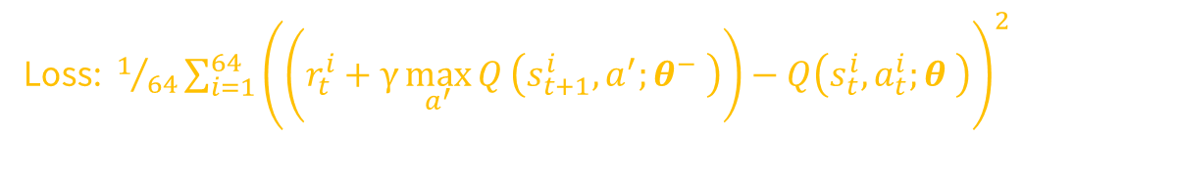
Loss: ${1/{64}\sum_{i=1}^{64}{\left(\left(r_{t}^{i}+γ\max_{a^{′}}{Q}\left(s_{t+1}^{i},a^{′};θ^{−} \right)\right)−Q\left(s_{t}^{i},a_{t}^{i};θ \right)\right)}}^{2}$
Double Q (2010) [14]
Q Learning (1992) [29]
Replay Buffer (1993) [16]
DQN (2013) [13]
Ape-X (2018) [19]
PER (2016) [18]
n-step Returns(1988) [23]
Noisy Nets (2017) [22]
Dueling DDQN (2016) [17]
DDQN (2015) [15]
C51 (2017) [24]
QR-DQN (2018) [25]
Observe (2018) [20]
R2D2 (2018) [21]
Rainbow (2017) [28]
D2RL (2020) [27]
IQN (2018) [26]
$$\frac{1}{64}\sum_{i=1}^{64}{\frac{1}{2}}w_{i}\sum_{t=0}^{80−\left(n−1\right)}{{\left(h\left(\sum_{k=0}^{n−1}{γ^{k}r_{t+k}^{i}} + γ^{n}h^{−1}\left(Q\left(s_{t+n}^{i},argmax_{a^{′}}Q\left(s_{t+n}^{i},a^{′};θ\right);θ^{−}\right)\right)\right)−Q\left(s_{t}^{i},a_{t}^{i};θ\right)\right)}^{2}}$$
Notes:
This equation looks quite daunting and therefore to give an insight into where each individual change came from we will quickly go over the contributions using colours to mark their origins.

Slide 22
Loss: ${1/{64}\sum_{i=1}^{64}{\left(\left(r_{t}^{i}+γ\max_{a^{′}}{Q}\left(s_{t+1}^{i},a^{′};θ^{−} \right)\right)−Q\left(s_{t}^{i},a_{t}^{i};θ \right)\right)}}^{2}$
Double Q (2010) [14]
Q Learning (1992) [29]
Replay Buffer (1993) [16]
DQN (2013) [13]
Ape-X (2018) [19]
PER (2016) [18]
n-step Returns(1988) [23]
Noisy Nets (2017) [22]
Dueling DDQN (2016) [17]
DDQN (2015) [15]
C51 (2017) [24]
QR-DQN (2018) [25]
Observe (2018) [20]
R2D2 (2018) [21]
Rainbow (2017) [28]
D2RL (2020) [27]
IQN (2018) [26]
$$\frac{1}{64}\sum_{i=1}^{64}{\frac{1}{2}}w_{i}\sum_{t=0}^{80−\left(n−1\right)}{{\left(h\left(\sum_{k=0}^{n−1}{γ^{k}r_{t+k}^{i}} + γ^{n}h^{−1}\left(Q\left(s_{t+n}^{i},argmax_{a^{′}}Q\left(s_{t+n}^{i},a^{′};θ\right);θ^{−}\right)\right)\right)−Q\left(s_{t}^{i},a_{t}^{i};θ\right)\right)}^{2}}$$
Notes:
This equation looks quite daunting and therefore to give an insight into where each individual change came from we will quickly go over the contributions using colours to mark their origins.

Slide 23
Loss: ${1/{64}\sum_{i=1}^{64}{\left(\left(r_{t}^{i}+γ\max_{a^{′}}{Q}\left(s_{t+1}^{i},a^{′};θ^{−} \right)\right)−Q\left(s_{t}^{i},a_{t}^{i};θ \right)\right)}}^{2}$
Double Q (2010) [14]
Q Learning (1992) [29]
Replay Buffer (1993) [16]
DQN (2013) [13]
Ape-X (2018) [19]
PER (2016) [18]
n-step Returns(1988) [23]
Noisy Nets (2017) [22]
Dueling DDQN (2016) [17]
DDQN (2015) [15]
C51 (2017) [24]
QR-DQN (2018) [25]
Observe (2018) [20]
R2D2 (2018) [21]
Rainbow (2017) [28]
D2RL (2020) [27]
IQN (2018) [26]
$$\frac{1}{64}\sum_{i=1}^{64}{\frac{1}{2}}w_{i}\sum_{t=0}^{80−\left(n−1\right)}{{\left(h\left(\sum_{k=0}^{n−1}{γ^{k}r_{t+k}^{i}} + γ^{n}h^{−1}\left(Q\left(s_{t+n}^{i},argmax_{a^{′}}Q\left(s_{t+n}^{i},a^{′};θ\right);θ^{−}\right)\right)\right)−Q\left(s_{t}^{i},a_{t}^{i};θ\right)\right)}^{2}}$$
Notes:
Firstly sampling weights in green have been included through the use of prioritized experience replay,
the original single step rewards have been replaced with nStep returns in pink,
and the action selection and value estimation stages have been decoupled through the use of double q learning in blue.

Slide 24
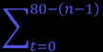
Loss: ${1/{64}\sum_{i=1}^{64}{\left(\left(r_{t}^{i}+γ\max_{a^{′}}{Q}\left(s_{t+1}^{i},a^{′};θ^{−} \right)\right)−Q\left(s_{t}^{i},a_{t}^{i};θ \right)\right)}}^{2}$
Double Q (2010) [14]
Q Learning (1992) [29]
Replay Buffer (1993) [16]
DQN (2013) [13]
Ape-X (2018) [19]
PER (2016) [18]
n-step Returns(1988) [23]
Noisy Nets (2017) [22]
Dueling DDQN (2016) [17]
DDQN (2015) [15]
C51 (2017) [24]
QR-DQN (2018) [25]
Observe (2018) [20]
R2D2 (2018) [21]
Rainbow (2017) [28]
D2RL (2020) [27]
IQN (2018) [26]
$$\frac{1}{64}\sum_{i=1}^{64}{\frac{1}{2}}w_{i}\sum_{t=0}^{80−\left(n−1\right)}{{\left(h\left(\sum_{k=0}^{n−1}{γ^{k}r_{t+k}^{i}} + γ^{n}h^{−1}\left(Q\left(s_{t+n}^{i},argmax_{a^{′}}Q\left(s_{t+n}^{i},a^{′};θ\right);θ^{−}\right)\right)\right)−Q\left(s_{t}^{i},a_{t}^{i};θ\right)\right)}^{2}}$$
Notes:
Furthermore, we are now using sequences of length 80 instead of a singular transition. This comes from r2d2 and is shown in blue.
We are also now applying value function re-scaling using the function h(x) shown in yellow.

Slide 25
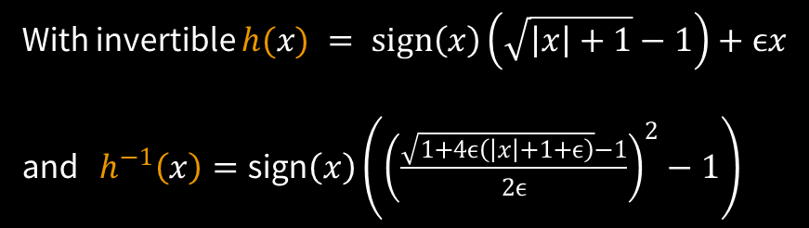
Loss: ${1/{64}\sum_{i=1}^{64}{\left(\left(r_{t}^{i}+γ\max_{a^{′}}{Q}\left(s_{t+1}^{i},a^{′};θ^{−} \right)\right)−Q\left(s_{t}^{i},a_{t}^{i};θ \right)\right)}}^{2}$
Double Q (2010) [14]
Q Learning (1992) [29]
Replay Buffer (1993) [16]
DQN (2013) [13]
Ape-X (2018) [19]
PER (2016) [18]
n-step Returns(1988) [23]
Noisy Nets (2017) [22]
Dueling DDQN (2016) [17]
DDQN (2015) [15]
C51 (2017) [24]
Observe (2018) [20]
With invertible $h(x) = \text{sign}\left(x\right)\left(\sqrt{\left|x\right|+1}−1\right)+ϵx$
and $h^{−1}\left(x\right)=\text{sign}\left(x\right)\left({\left(\frac{\sqrt{1+4ϵ\left(\left|x\right|+1+ϵ\right)}−1}{2ϵ}\right)}^{2}−1\right)$
R2D2 (2018) [21]
$$\frac{1}{64}\sum_{i=1}^{64}{\frac{1}{2}}w_{i}\sum_{t=0}^{80−\left(n−1\right)}{{\left(h\left(\sum_{k=0}^{n−1}{γ^{k}r_{t+k}^{i}} + γ^{n}h^{−1}\left(Q\left(s_{t+n}^{i},argmax_{a^{′}}Q\left(s_{t+n}^{i},a^{′};θ\right);θ^{−}\right)\right)\right)−Q\left(s_{t}^{i},a_{t}^{i};θ\right)\right)}^{2}}$$
Notes:
We are also now applying value function re-scaling using the function h(x).
As you can see, all of the remaining parts in white have come from the original dqn algorithm.
Questions?
So now the only part left ambiguous about this loss function is the Q-network itself:

Slide 26
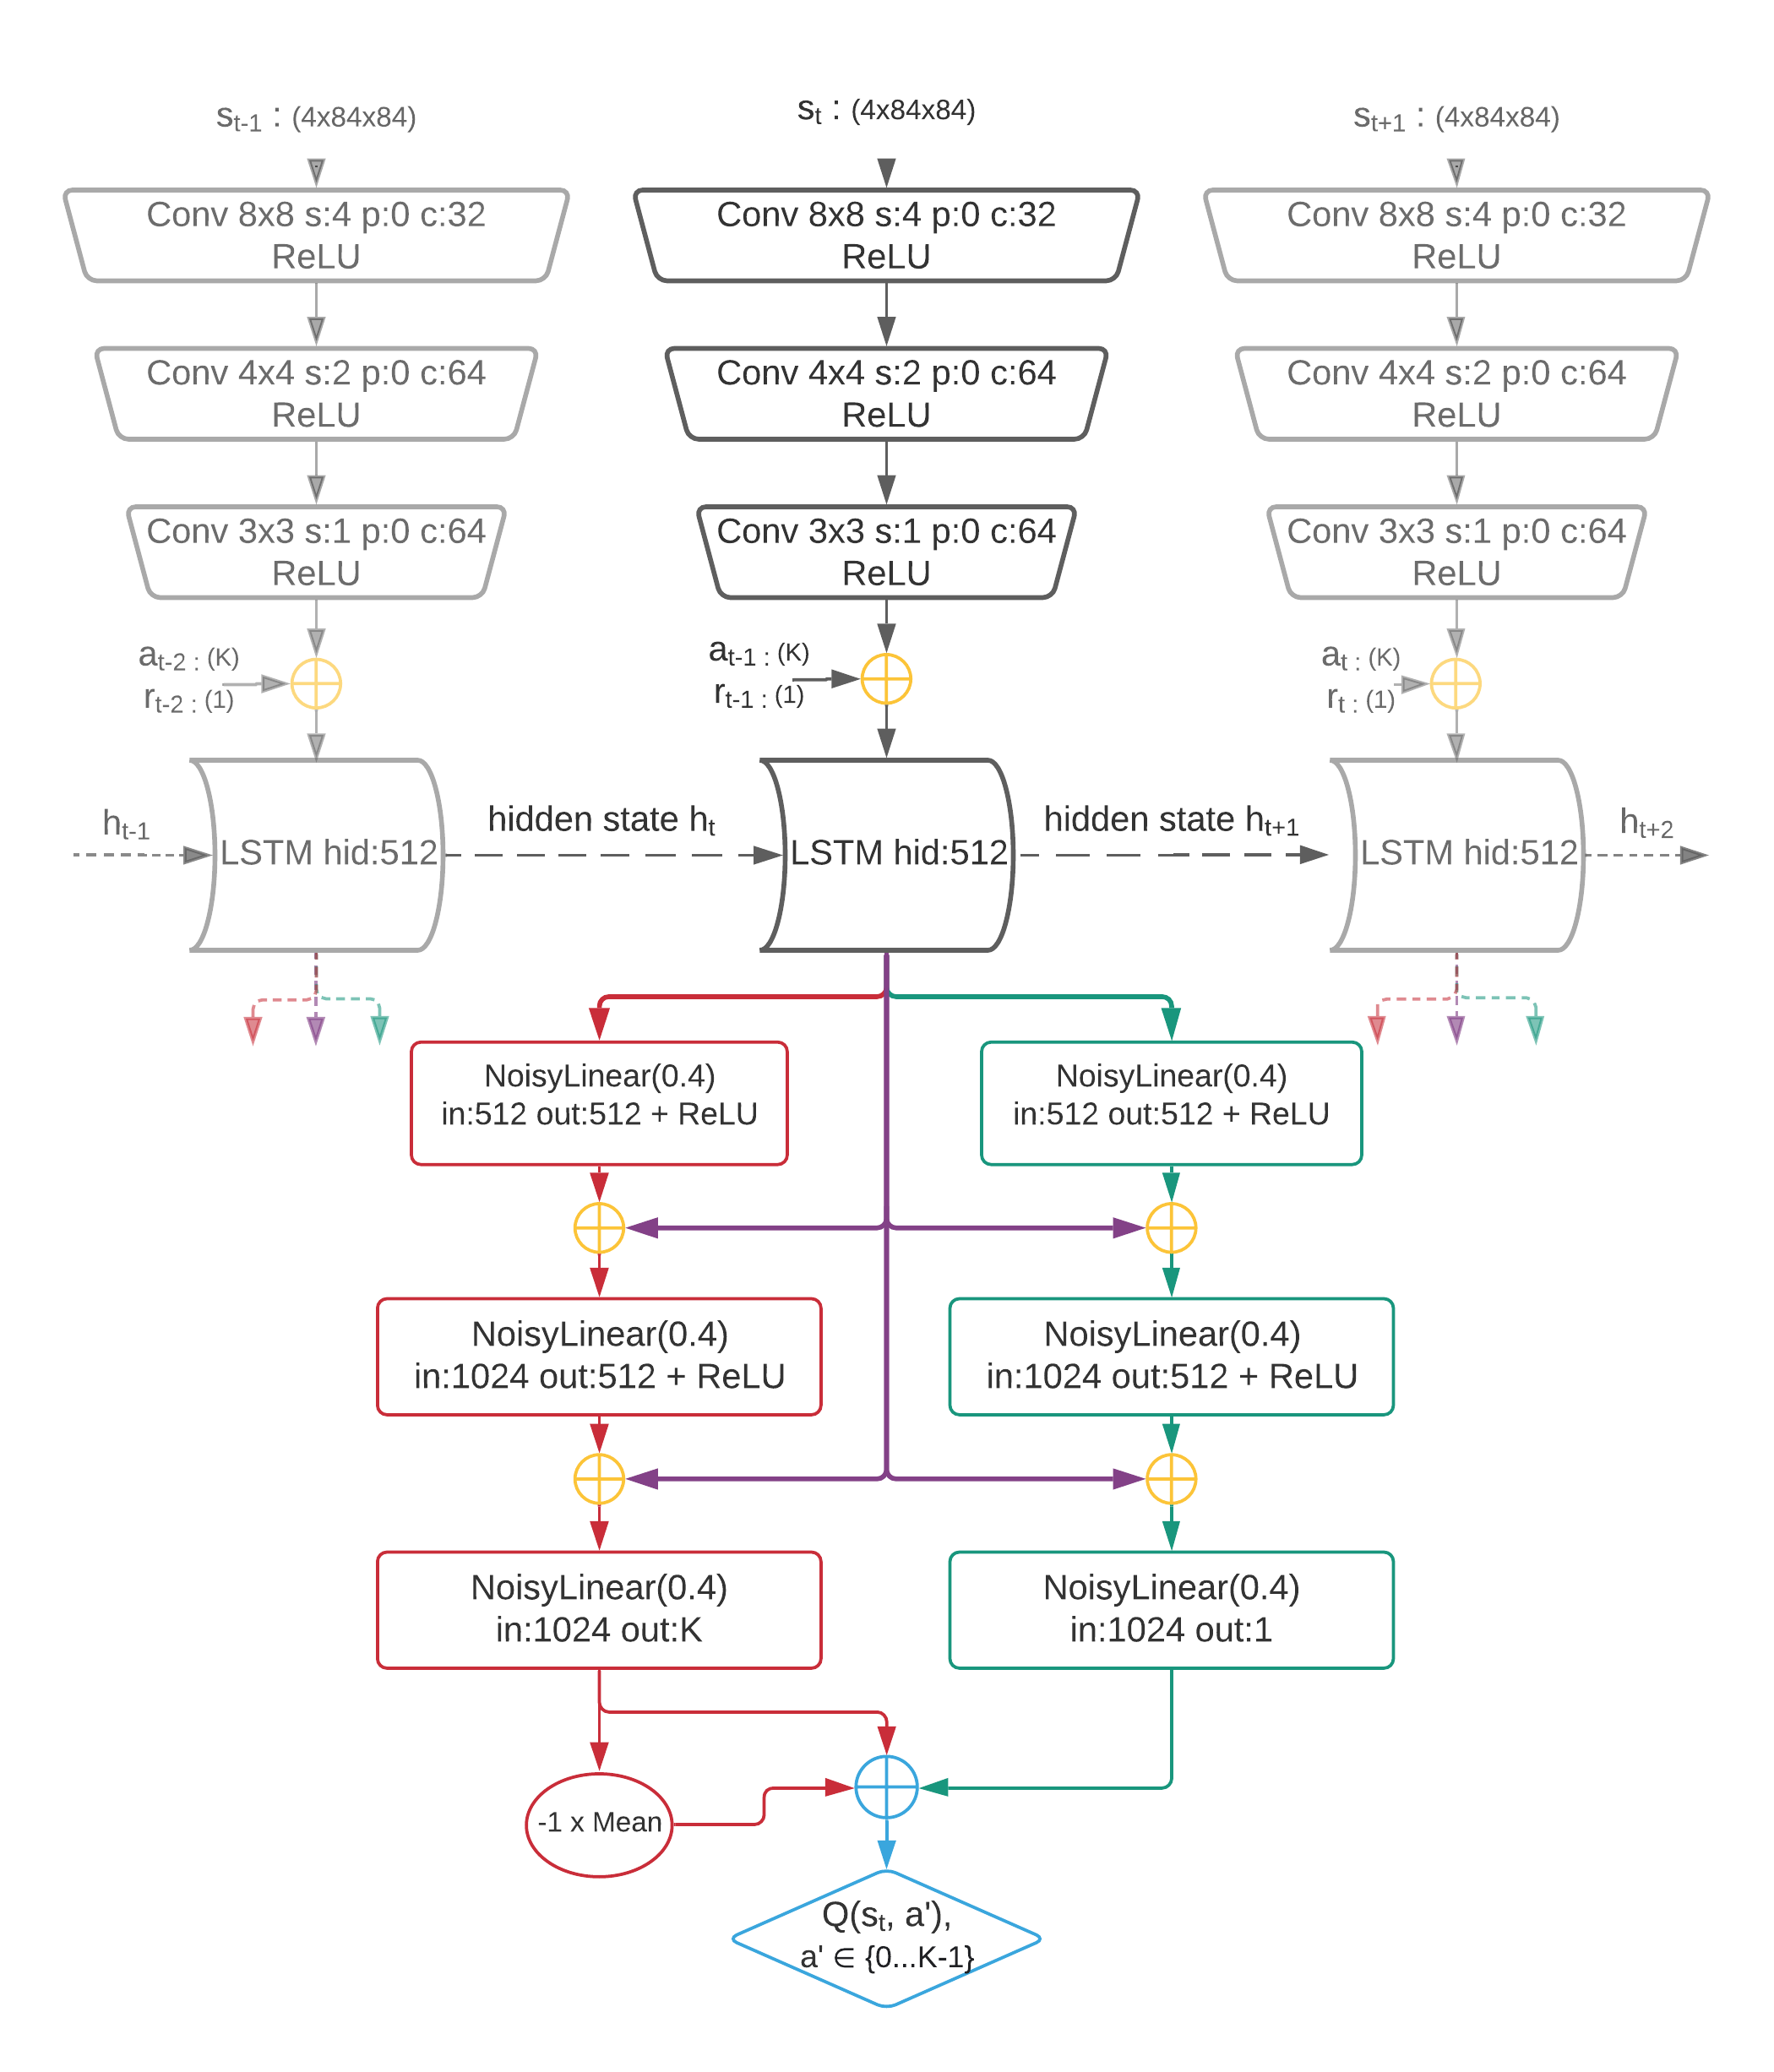
OUR Q-Network architecture
$$Q\left(s_{t},a_{t};θ \right)$$
Notes:
Our QNetwork is composed of a convolutional stack leading into an LSTM followed up a dueling architecture of noisy linear layers.
This network takes as an input a stack of 4 gray scale frames taken directly from super mario bros alongside the previous action reward, and outputs a q-value estimate for each possible action from the current state.

Slide 27
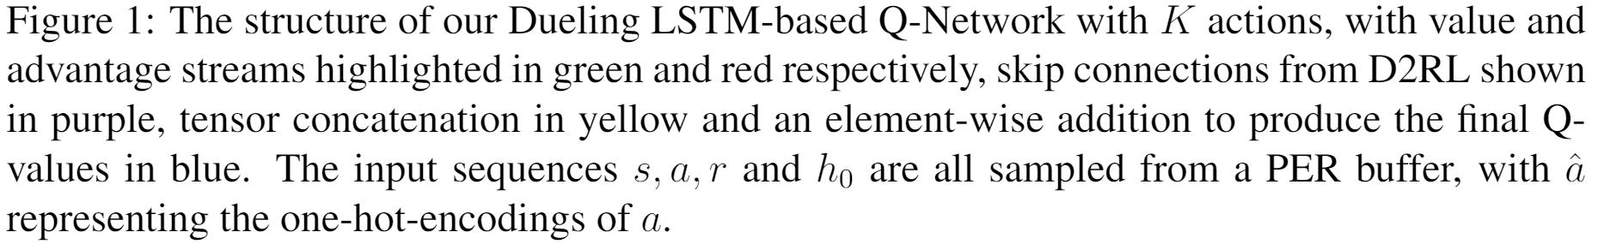
OUR Q-Network architecture
$$Q\left(s_{t},a_{t};θ \right)$$
Notes:
Our QNetwork is composed of a convolutional stack leading into an LSTM followed up a dueling architecture of noisy linear layers.
This network takes as an input a stack of 4 gray scale frames taken directly from super mario bros alongside the previous action and reward, and outputs a q-value estimate for each possible action from the current state.

Slide 28
OUR Q-Network architecture
R2D2 (2018) [21]
D2RL (2020) [27]
$$Q\left(s_{t},a_{t};θ \right)$$
Dueling DDQN (2016) [17]
Noisy Nets (2017) [22]
Notes:
Once again, this Q-network comprises contributions from a variety of academic works, and is color coordinated accordingly to show the origins of each contribution.

Slide 29
OUR Q-Network architecture
R2D2 (2018) [21]
D2RL (2020) [27]
$$Q\left(s_{t},a_{t};θ \right)$$
Dueling DDQN (2016) [17]
Noisy Nets (2017) [22]
Notes:
Once again, this Q-network comprises contributions from a variety of academic works, and is color coordinated accordingly to show the origins of each contribution.

Slide 30
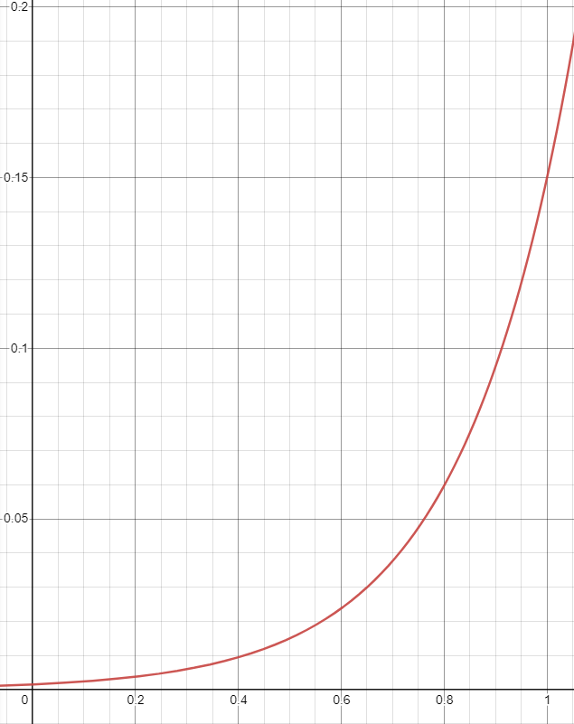
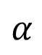

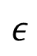


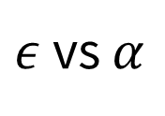
OUR distributed $ε$-greedy exploration scheme
$ε$ vs $α$
$$ε$$
$ϵ_{i}=1.5×{0.1}^{α_{i}+3\left(1−α_{i}\right)}$,
where $α_{i}=\frac{i}{m−1}$
and $m$ is number of actors
(for each level)
$$α$$
Notes:
In order to ensure sufficient exploration of the state space and that the algorithm doesnt converge to a local minimal, we explored and experimented with a variety of options.
We settled upon a distributed epsilon greedy exploration scheme wherein every actor for an individual level has a differing epsilon to allow for both shallow and deep exploration of the state space.

Slide 31
OUR distributed $ε$-greedy exploration scheme
$ε$ vs $α$
Observe (2018) [20]
$$ε$$
$ϵ_{i}=1.5×{0.1}^{α_{i}+3\left(1−α_{i}\right)}$,
where $α_{i}=\frac{i}{m−1}$
and $m$ is number of actors
(for each level)
$$α$$
Notes:
This particular scheme was inspired by that used in Observe and look further.
Questions?

Slide 32
Toy Demo of Agent’s action selection:
Best Action = ${argmax}_{a}(Q(s,a))$
AGENT
ENVIRONMENT
Action
Reward
Notes:
We will now show a toy real-time demo of the agent selecting actions on a frame-by-frame basis, depicting the action-selection cycle shown in the following diagram to allow for a better understanding of how R2D4+ works.

Slide 33
OUR Reward function
$r_{t}=v_{t}+Δclock_{t}+d_{t}+\frac{Δscore_{t}}{200}+ΔM_{t}$ ,

Slide 34
OUR Reward function
Kauten (2018) [30]
$r_{t}=v_{t}+Δclock_{t}+d_{t}+\frac{Δscore_{t}}{200}+ΔM_{t}$ ,

Slide 35
The Deliverables
Notes:
The project itself will be evaluated using a list of deliverables assessing the agent’s skill, generalizability, memory and speed, alongside the understanding gained and demonstrated during the project itself.

Slide 36
Skill based Deliverables:
Implement an agent which is able to consistently complete (when trained solely on the equivalent level):
a singular easy level, specifically 1-1;
a singular difficult level, specifically 5-1 and 7-3.
Notes:
Firstly we have three skill-based deliverables, which assess the agents ability to complete difficult levels.
For deliverable one we train test and evaluate the agent on a training set consisting of a singular level.
In this setting, the agent is allowed to over fit to the training set with no regularization whatsoever.
This assesses the agents maximum skill, and is akin to the learning conditions of a player when attempting to speed run a particular level, as they do not need to concentrate on performing well on and learning all other levels simultaneously.

Slide 37
Skill based Deliverables:
Implement an agent which is able to consistently complete (when trained solely on the equivalent level):
a singular easy level, specifically 1-1;
a singular difficult level, specifically 5-1 and 7-3.
✓
Notes:
First and foremost, is to implement the overall framework in which an agent would learn.
This includes an implementation of the Super Mario Bros environment, an Agent which is able to interact with this environment and the design of a reward function for use in QLearning.
Once that is done, the next step would be to implement the DQN framework, and in doing so attempt to produce an agent which shows positive convergence when trained on a singular easy level specifically level 1-1.
By positive convergence we mean that the agents learning curve of training scores shows a positive trend.

Slide 38
Skill based Deliverables:
Implement an agent which is able to consistently complete (when trained solely on the equivalent level):
a singular easy level, specifically 1-1;
a singular difficult level, specifically 5-1 and 7-3.
✓
✓

Slide 39
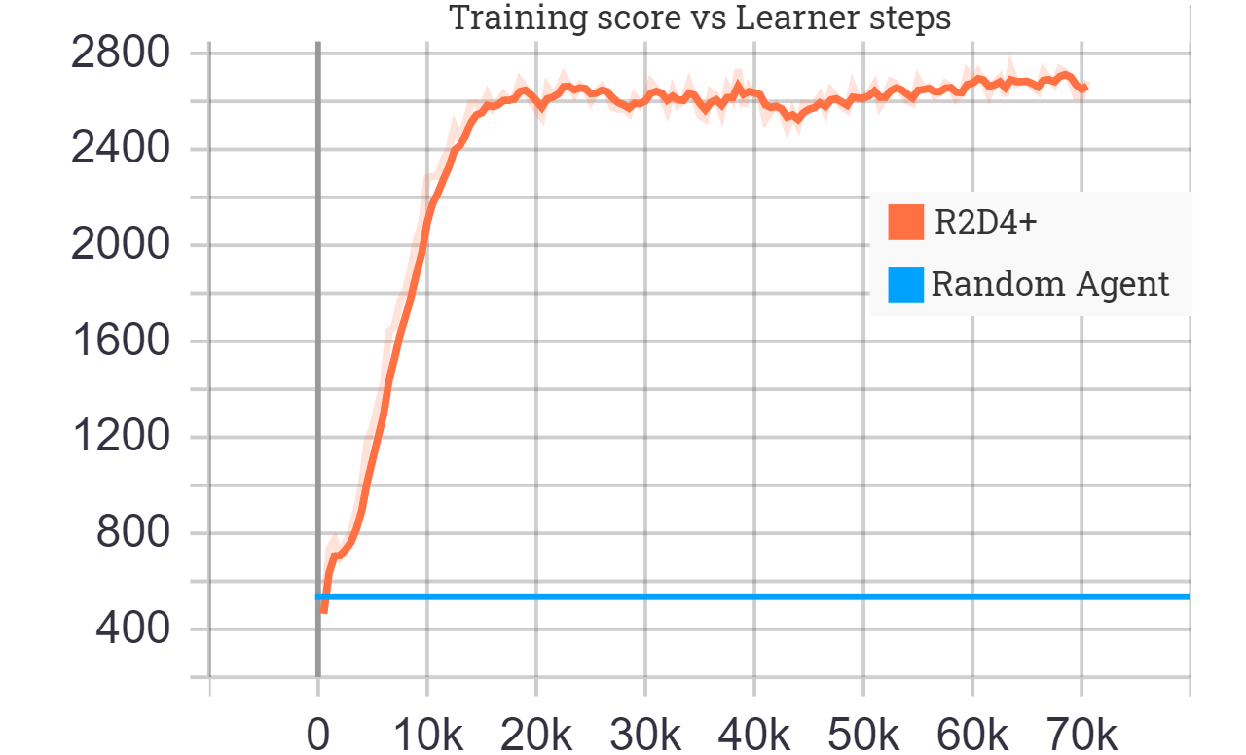
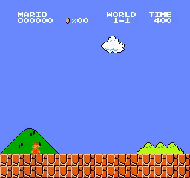
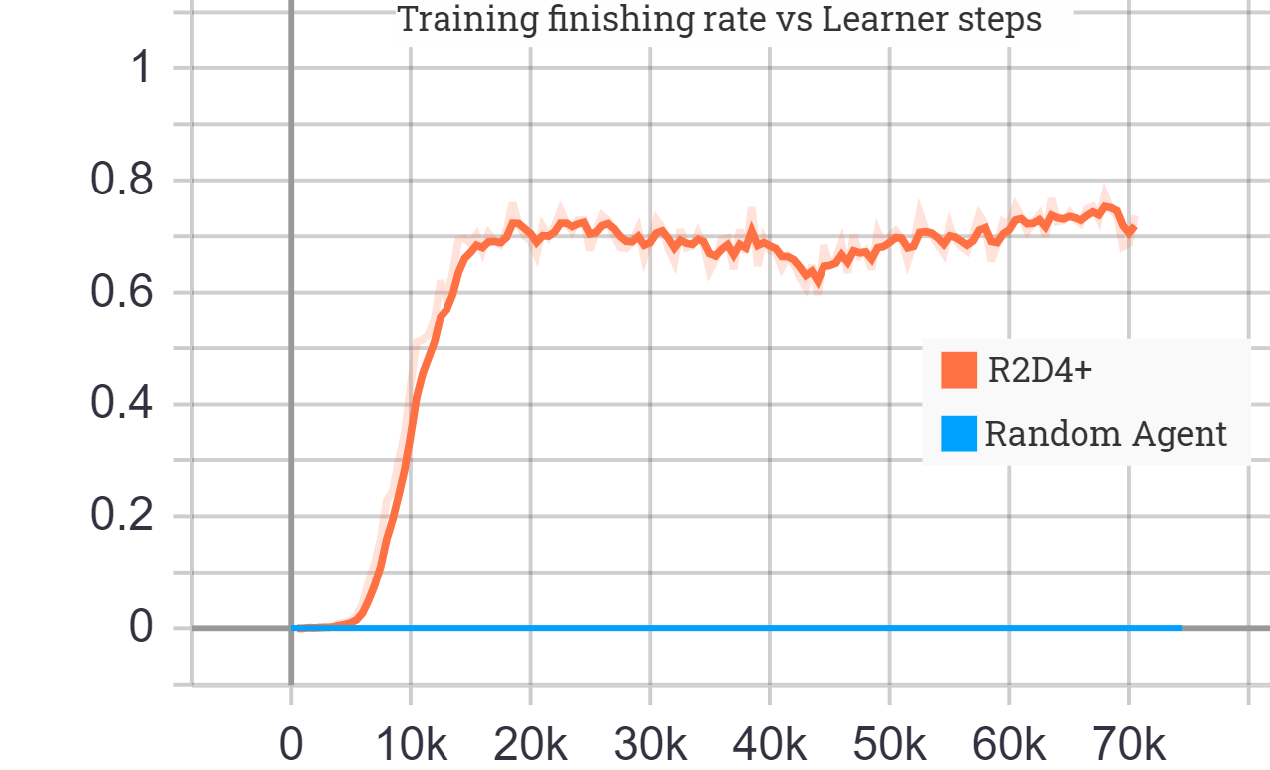
1a.
Training the agent on level 1-1:
Note, 10k Learner steps equates to 25 million environment frames.

Slide 40
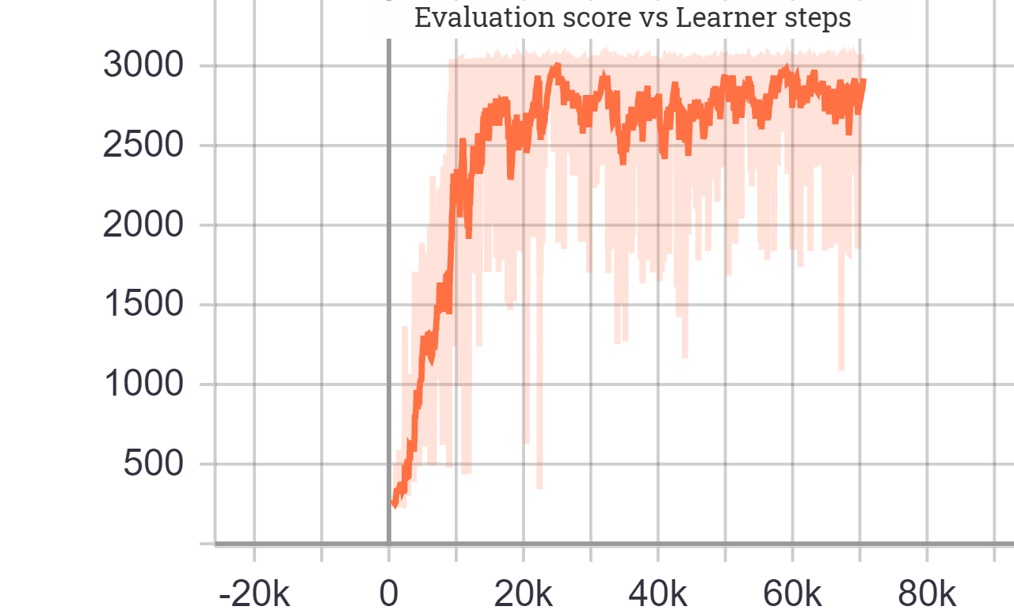
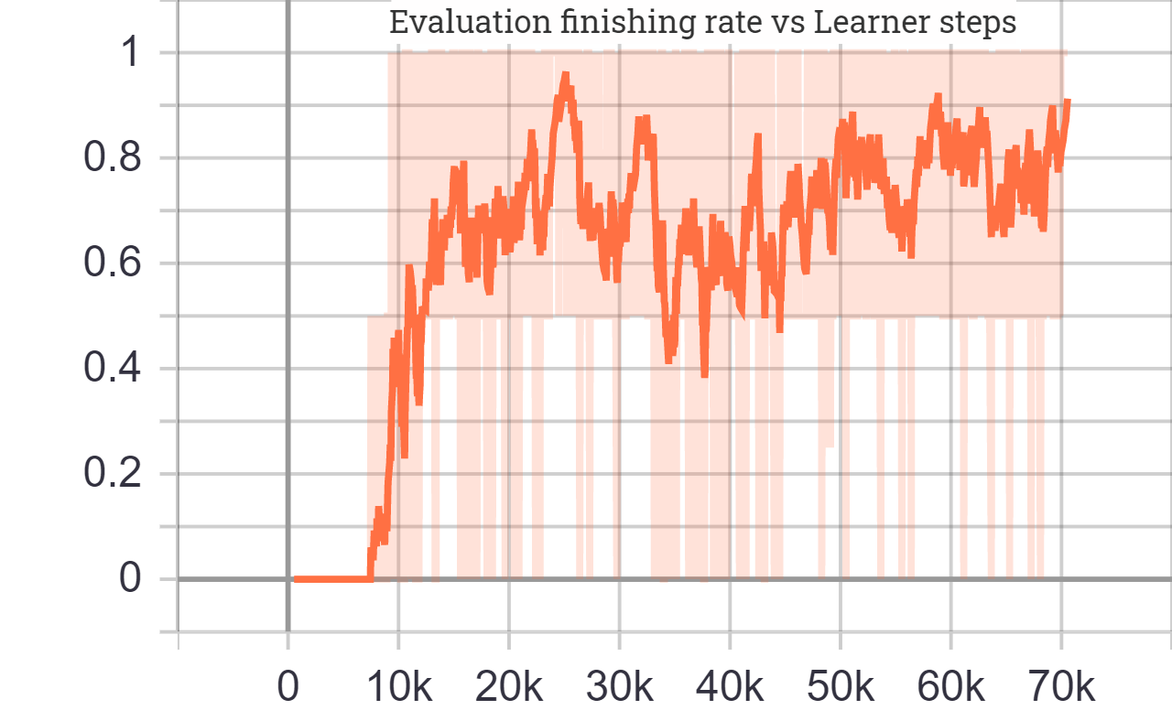
1a.
Training the agent on level 1-1:
Note, 10k Learner steps equates to 25 million environment frames.

Slide 41
Skill based Deliverables:
Implement an agent which is able to consistently complete (when trained solely on the equivalent level):
a singular easy level, specifically 1-1;
a singular difficult level, specifically 5-1 and 7-3.
✓
Notes:
First and foremost, is to implement the overall framework in which an agent would learn.
This includes an implementation of the Super Mario Bros environment, an Agent which is able to interact with this environment and the design of a reward function for use in QLearning.
Once that is done, the next step would be to implement the DQN framework, and in doing so attempt to produce an agent which shows positive convergence when trained on a singular easy level specifically level 1-1.
By positive convergence we mean that the agents learning curve of training scores shows a positive trend.

Slide 42
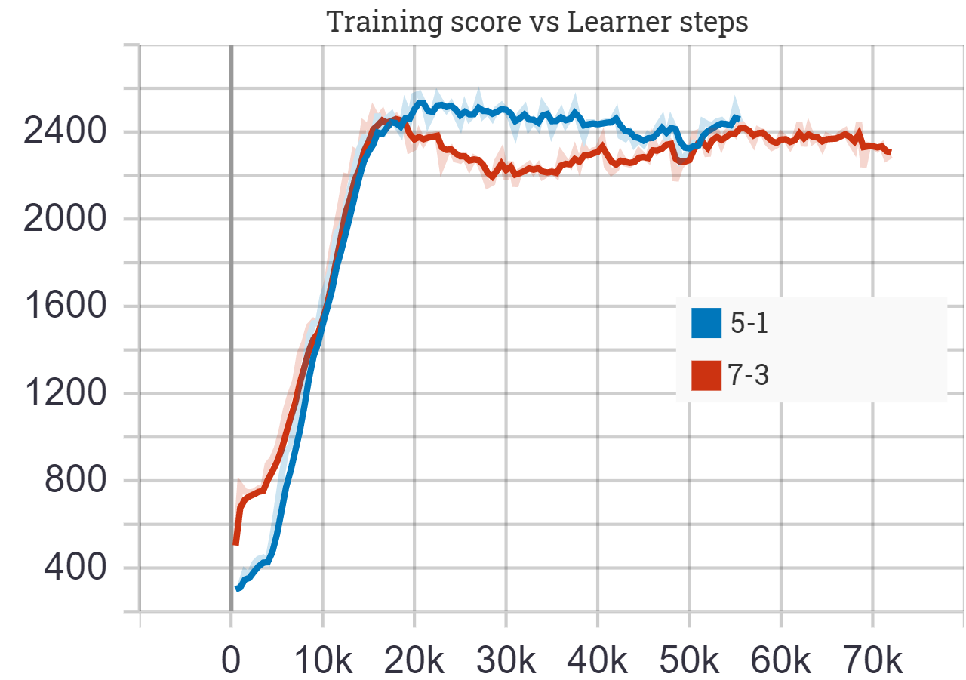
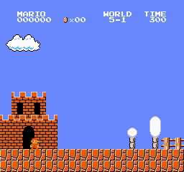
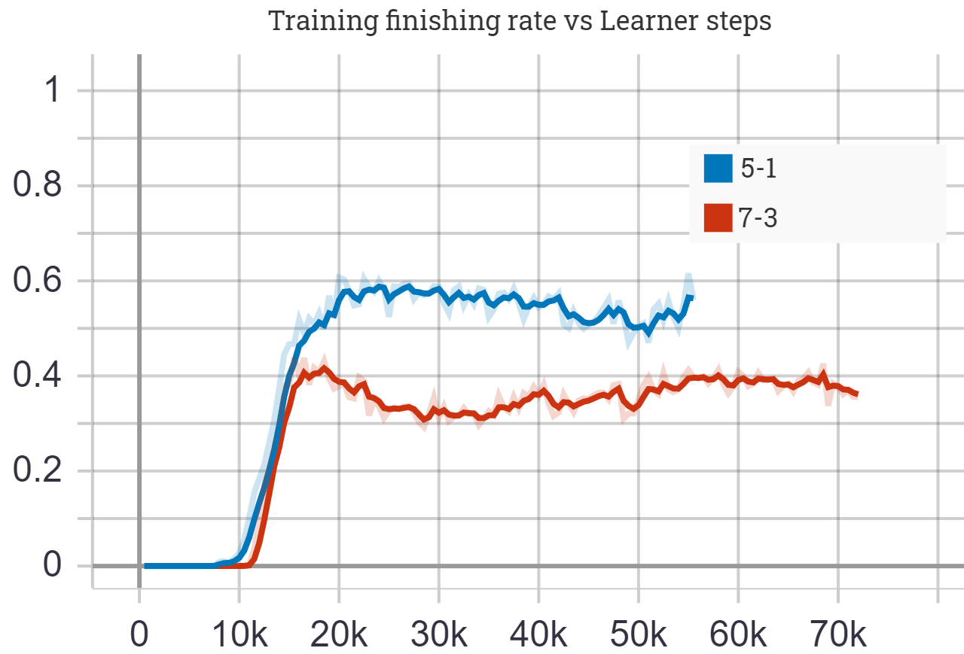
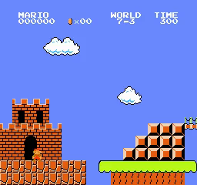
1b.
Training the agent on a singular hard level (5-1 and 7-3):
Note, 10k Learner steps equates to 25 million environment frames.

Slide 43
Skill based Deliverables:
Implement an agent which is able to consistently perform well on all and complete most levels of (when trained solely on the equivalent 4 levels):
a singular easy world, specifically World 1;
a singular difficult world, specifically Worlds 5 and 7.
Notes:
Deliverable 2 then increases the training set size from a singular level to a whole world, thus quadrupling its size.
This starts to limit the agents ability to over fit, and starts to encourage the agent to instead begin to learn how the game itself works.
Once again we train test and evaluate on an easy world and subsequently two difficult worlds.

Slide 44
Skill based Deliverables:
Implement an agent which is able to consistently perform well on all and complete most levels of (when trained solely on the equivalent 4 levels):
a singular easy world, specifically World 1;
a singular difficult world, specifically Worlds 5 and 7.
✓
✓

Slide 45
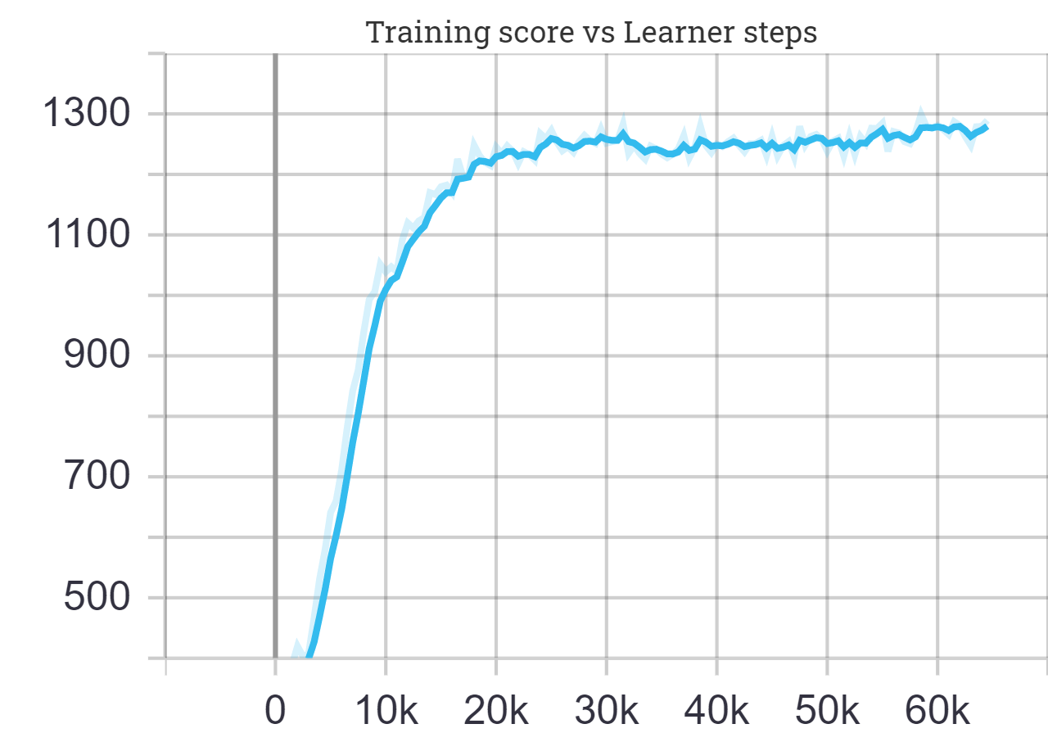

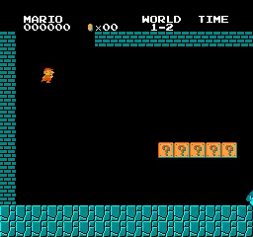
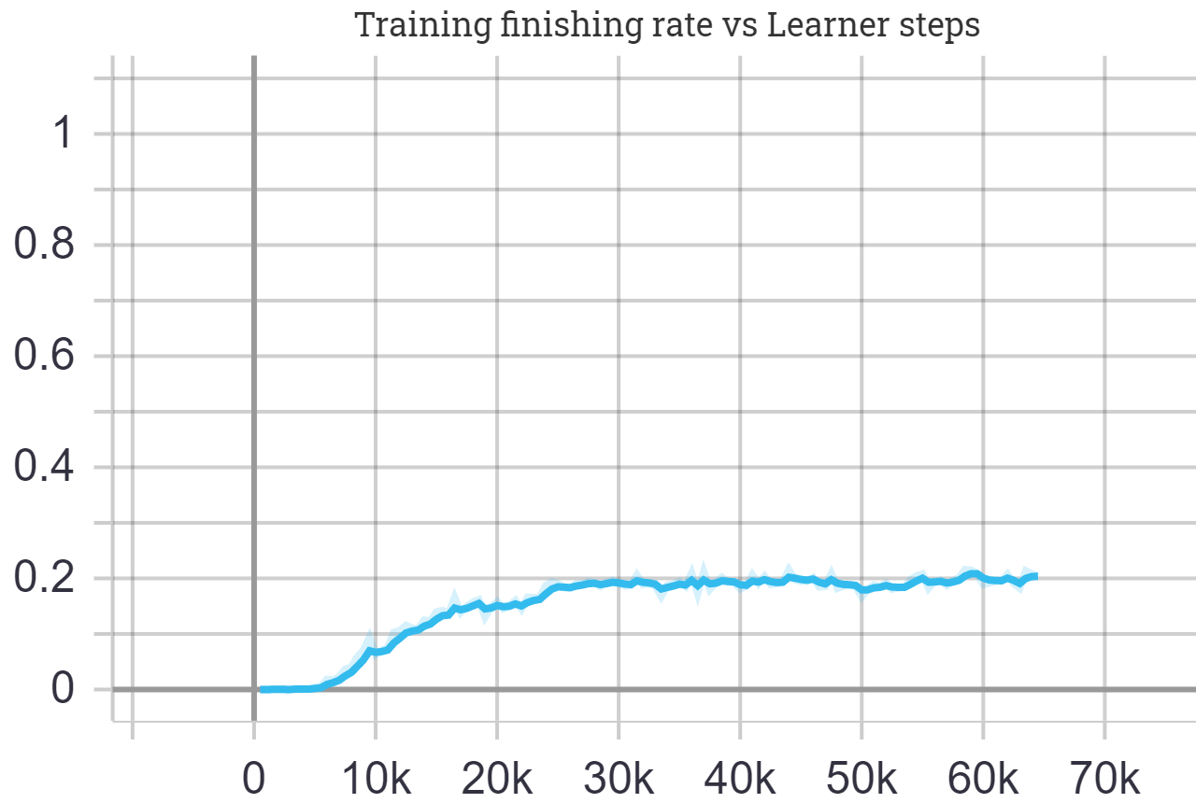
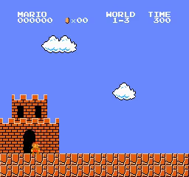
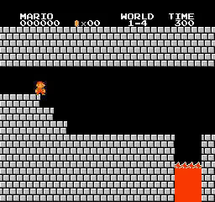
2a.
Training the agent on a singular easy world (World 1):

Slide 46
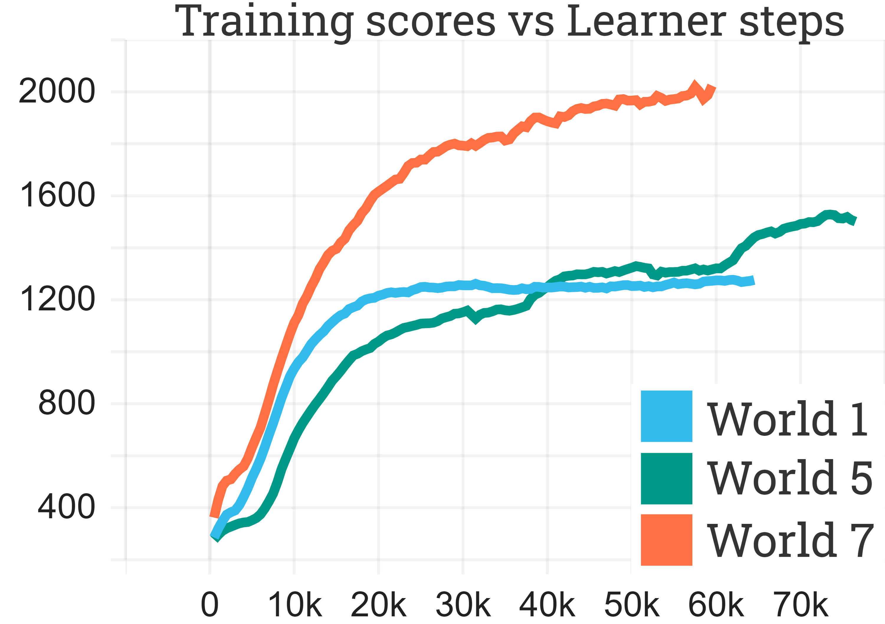

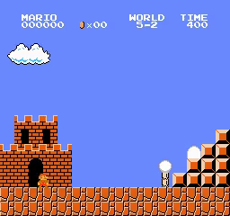

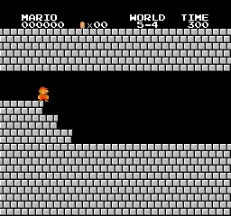
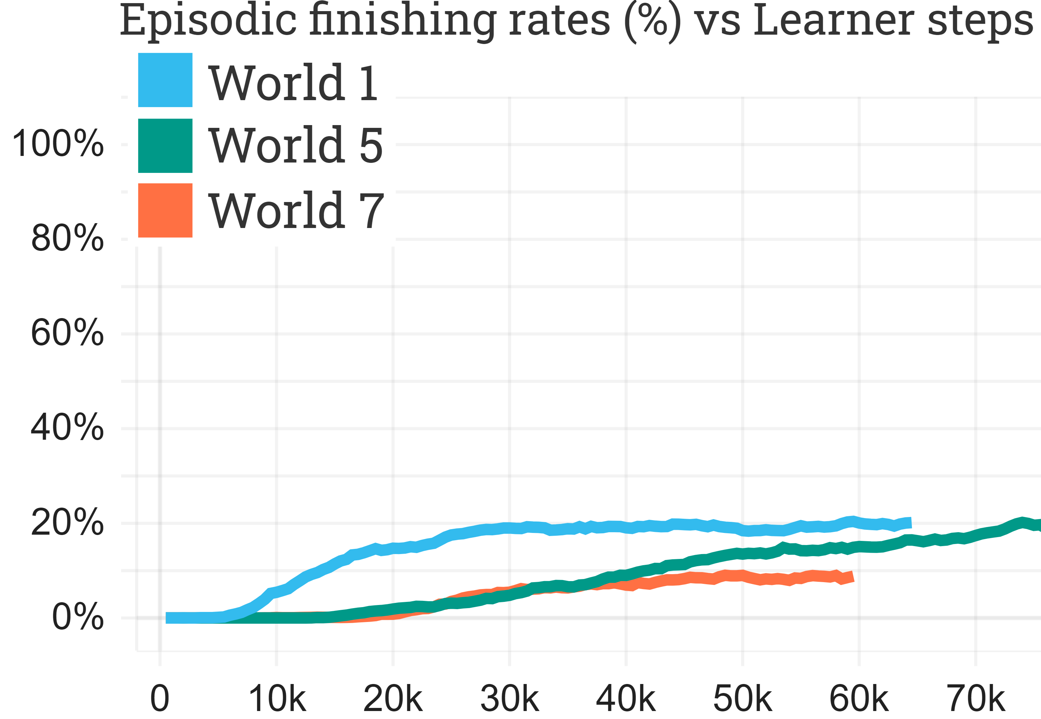
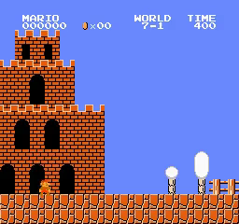
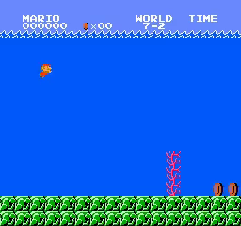


2b.
Training the agent on a singular difficult world (World 5 and 7):

Slide 47
Skill based Deliverables:
Implement an agent which is able to consistently perform well on all of and often complete many of the levels on a training set consisting of the whole game (32 levels) minus a small set of 4 evaluation levels, specifically 1-1, 2-1, 3-2 and 6-4.
Notes:
To the same end as Deliverable 2, deliverable 3 then increase the training set size from 4 to 28, which is almost the entire game.
This is once again done to limit the agent's ability to over fit, and attempt to ensure that the agent is instead learning the core mechanics and rules behind the game.
This also tests the agent's ability to juggle between performing well on and learning a large variety levels at once.

Slide 48
Skill based Deliverables:
Implement an agent which is able to consistently perform well on all of and often complete many of the levels on a training set consisting of the whole game (32 levels) minus a small set of 4 evaluation levels, specifically 1-1, 2-1, 3-2 and 6-4.
✓

Slide 49
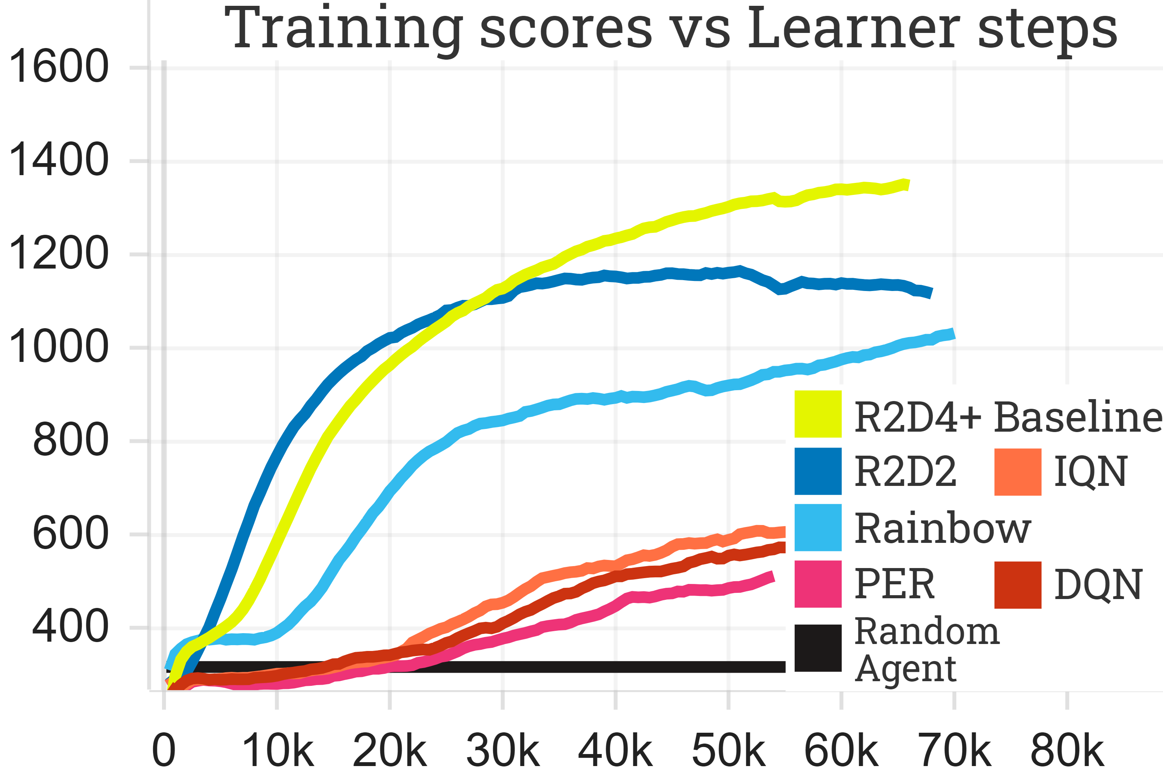
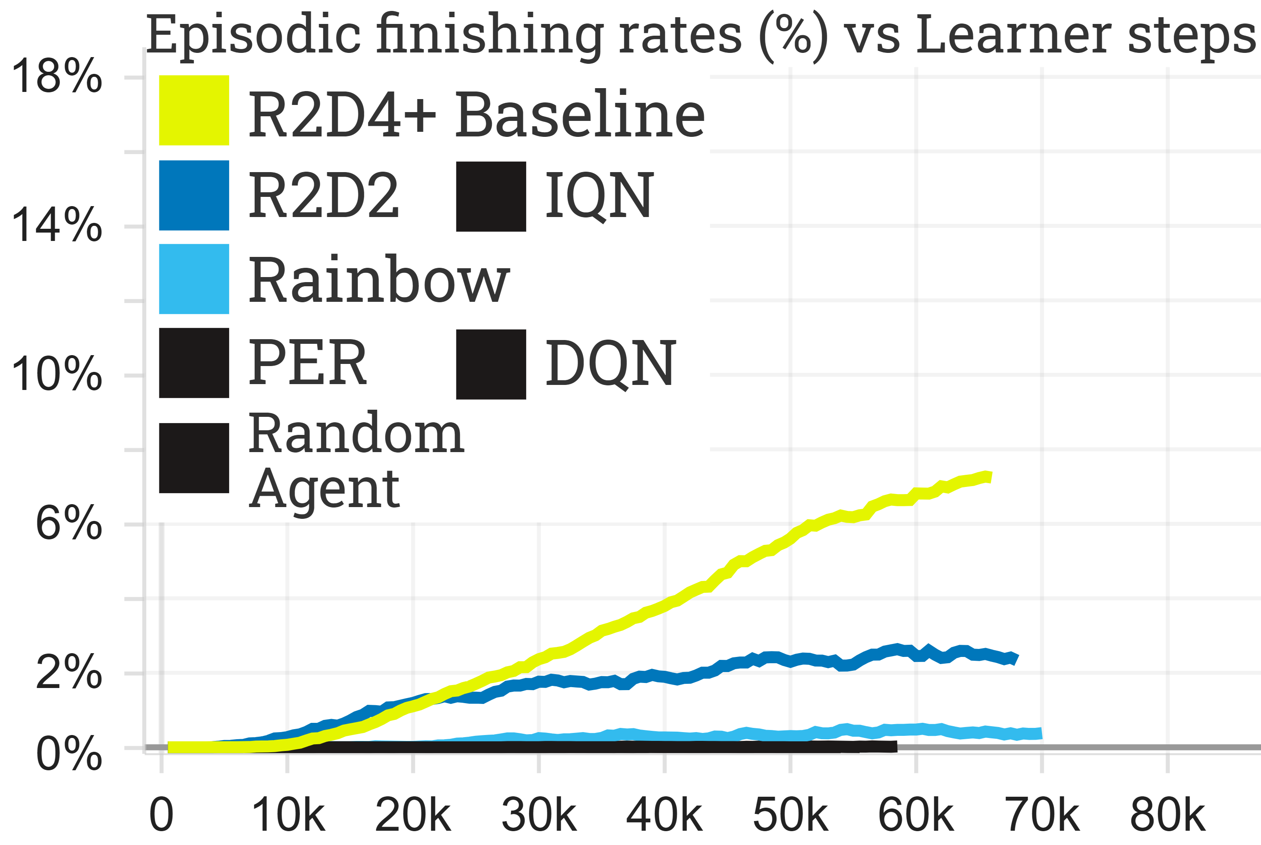
3.
Training the agent on the whole game (almost):

Slide 50
Generalizability Deliverables:
Implement an agent which when trained on the whole game minus a small evaluation set of levels (which it is never trained on) is able to generalize and consistently perform well on and sometimes complete an out-of-sample:
easy level (1-1);
medium difficulty level (2-1);
difficult level (3-2 and 6-4).
Notes:
In order to evaluate the phenomena we have been trying to enforce via slowly increasing the training set size from 1 all the way to 28, deliverable 4 tests the generalizability power of the agent.
This is done by evaluating the agent on a small set of 4 diverse out-of-sample levels which are removed from the training set, and thus the agent is never trained on them.
This deliverable therefore tests the true skill of the agent, as the agent is not capable of over fitting to something it has never been trained upon and therefore any success on these levels is entirely derived from the agents insights into and understanding of the game.
This deliverable is also the reason that 4 levels were removed from the entire game to make the training set for deliverable 3.

Slide 51
Generalizability Deliverables:
Implement an agent which when trained on the whole game minus a small evaluation set of levels (which it is never trained on) is able to generalize and consistently perform well on and sometimes complete an out-of-sample:
easy level (1-1);
medium difficulty level (2-1);
difficult level (3-2 and 6-4).
✓
✓
✓

Slide 52
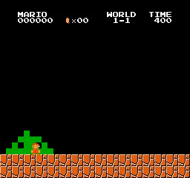
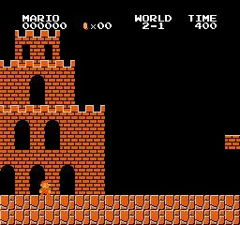
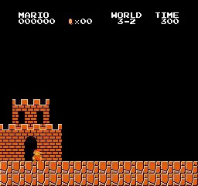

4.
Evaluating the agent on levels it has never been trained on:
3% of the time.
Occasionally – one unfamiliar obstacle at end.
6% of the time.
Occasionally – extremely difficult.
For reference:
average in-sample rate was 6.5%

Slide 53
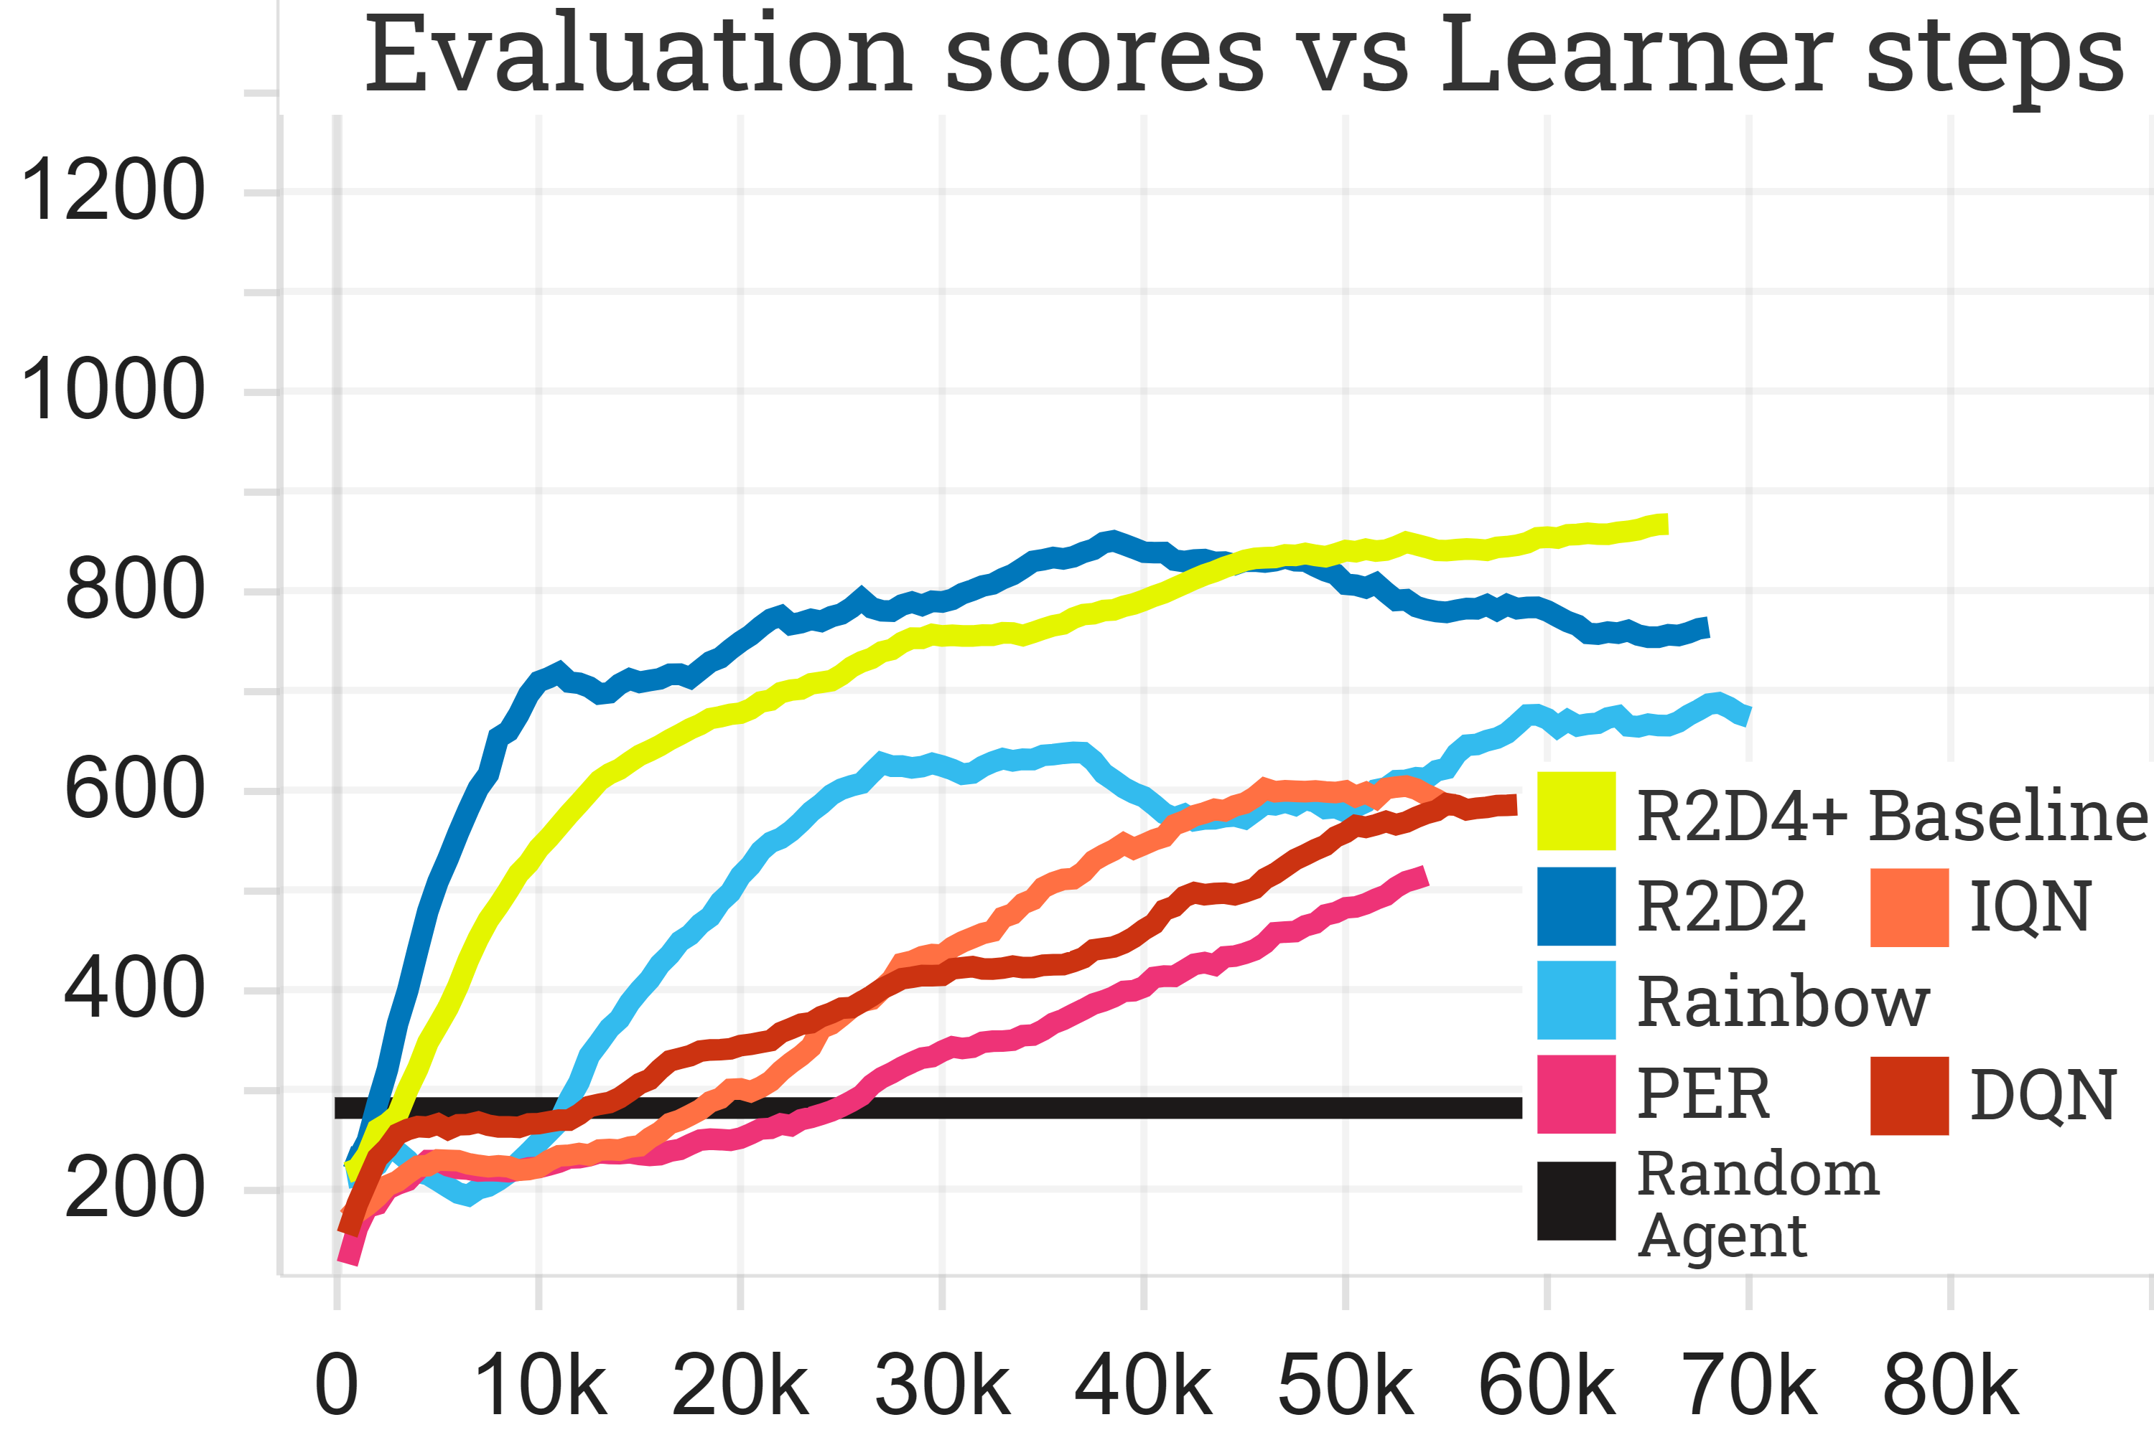
4.
Evaluating the agent on levels it has never been trained on:

Slide 54
Memory Deliverables:
Implement an agent that is able to consistently perform well on a difficult level that requires the use of long-term memory, specifically to get out of infinite room loops for which Super Mario Bros’ later levels are famous.
Notes:
We now move on to the memory deliverable, which is one of the hardest deliverables in this project, namely to design an agent capable of leveraging it's long-term memory to consistently escape the infinite room loops that super mario bros later levels are so famous for.
However, this is a famously difficult task within the reinforcement learning field and unfortunately this was the one deliverable that we were not able to deliver.

Slide 55
Memory Deliverables:
Implement an agent that is able to consistently perform well on a difficult level that requires the use of long-term memory, specifically to get out of infinite room loops for which Super Mario Bros’ later levels are famous.
✗

Slide 56
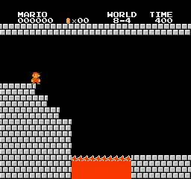
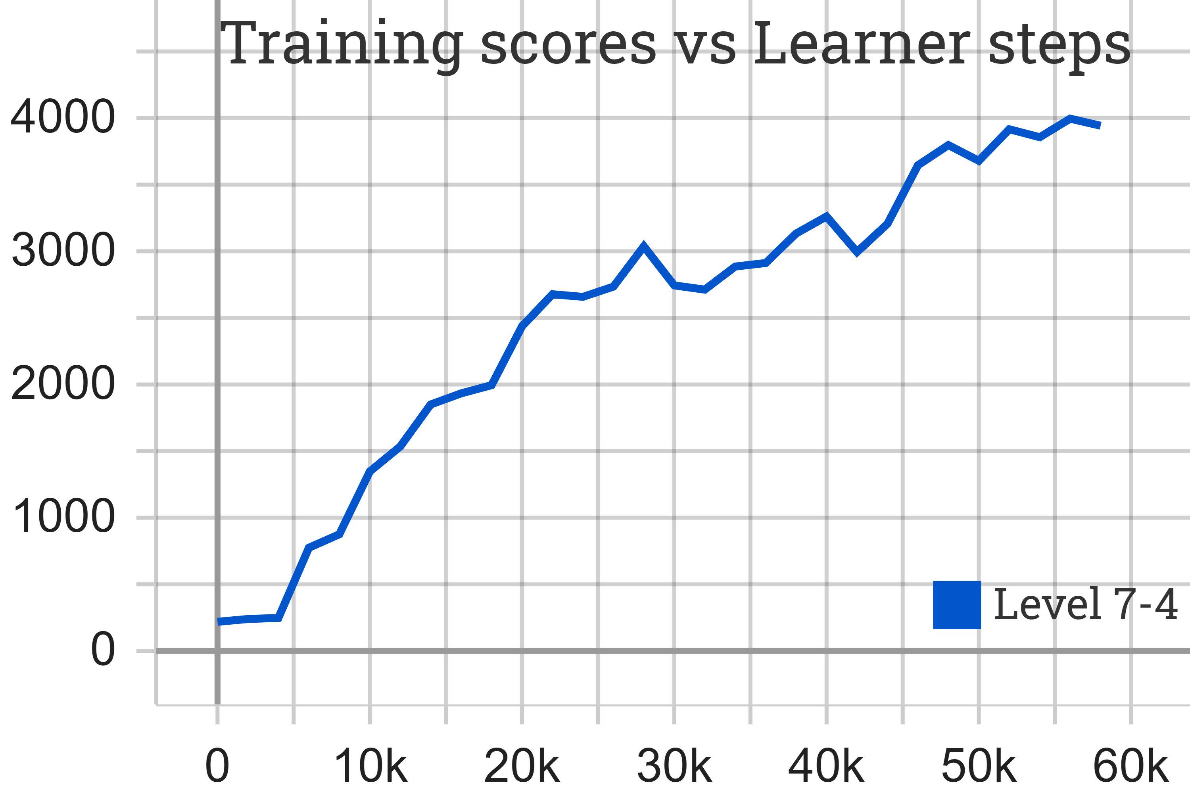
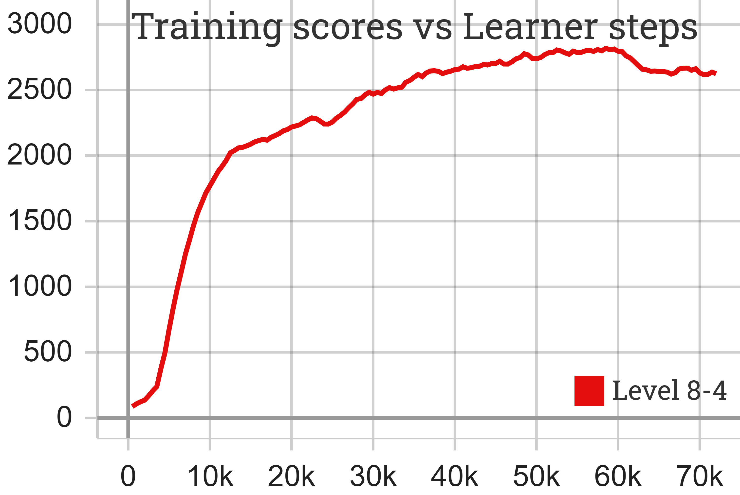
5.
Evaluating the agent’s ability to leverage its long term memory:

Slide 57
Speed Deliverables:
Implement an agent which is able to perform similar to or out-perform a small sample of expert players on their best time to complete the following levels: 1-1, 2-1, 3-2, 5-1, 6-4 & 7-3.
Notes:
At the very beginning of this presentation, I stated that what determines a players skill in super mario bros is there ability to complete difficult levels along with how fast they can do so.
Well deliverable 6 tests the latter, namely by evaluating the agent’s speed by comparing it against a small sample of expert players on their best times to speed run a diverse set of levels taken from varying difficulties throughout the game.

Slide 58
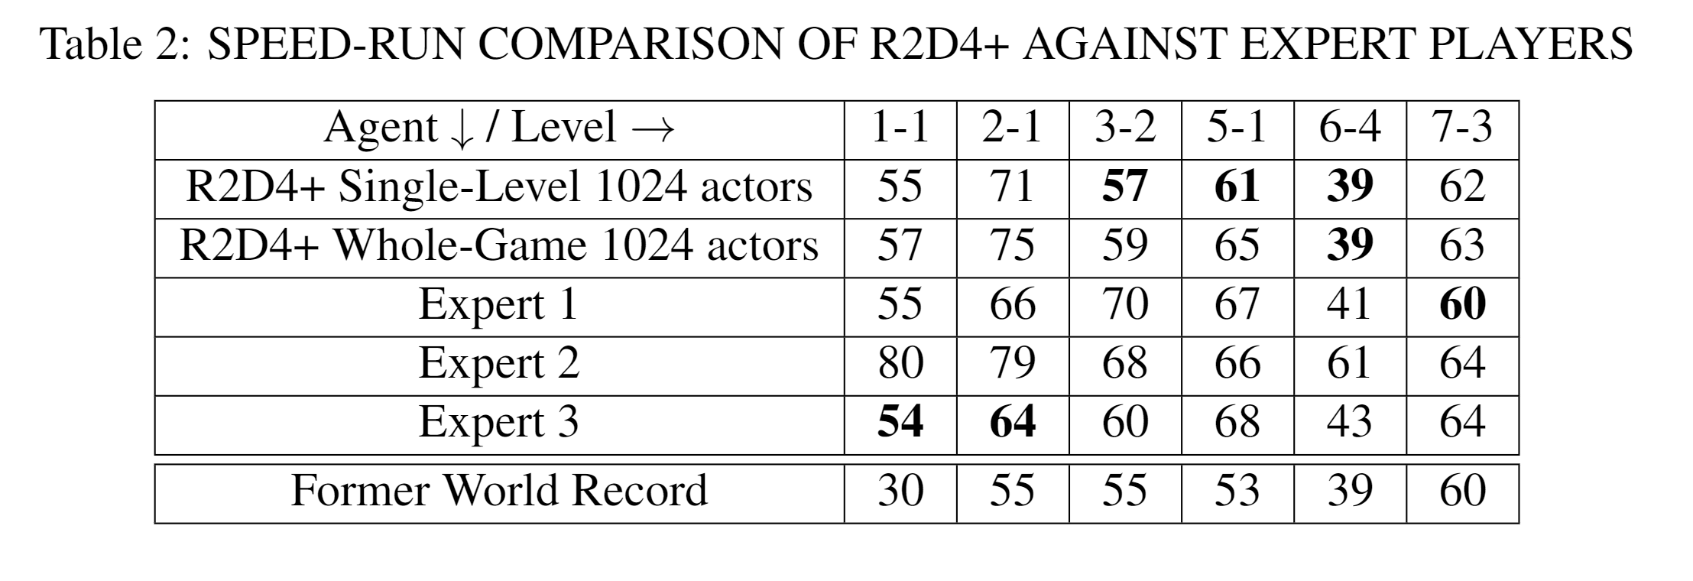
Speed Deliverables:
Implement an agent which is able to perform similar to or out-perform a small sample of expert players on their best time to complete the following levels: 1-1, 2-1, 3-2, 5-1, 6-4 & 7-3.
✓

Slide 59
Knowledge and Understanding Deliverables:
To develop a deep understanding of agent produced, and thereby the subset of Reinforcement Learning surveyed, and to show evidence for or against the orthogonality of the various contributions incorporated into R2D4+; this understanding will be primarily demonstrated through ablation studies of the agent’s abilities.
Notes:
The final deliverable is to develop and display a deep understanding of the agent produced, and thereby the subset of reinforcement learning surveyed, and to show evidence for or against the or orthogonality of each individual component incorporated into R2D4+.
This understanding will be primarily demonstrated through extensive ablation studies of the agents performance on a variety of levels.

Slide 60
Knowledge and Understanding Deliverables:
To develop a deep understanding of agent produced, and thereby the subset of Reinforcement Learning surveyed, and to show evidence for or against the orthogonality of the various contributions incorporated into R2D4+; this understanding will be primarily demonstrated through ablation studies of the agent’s abilities.
✓

Slide 61
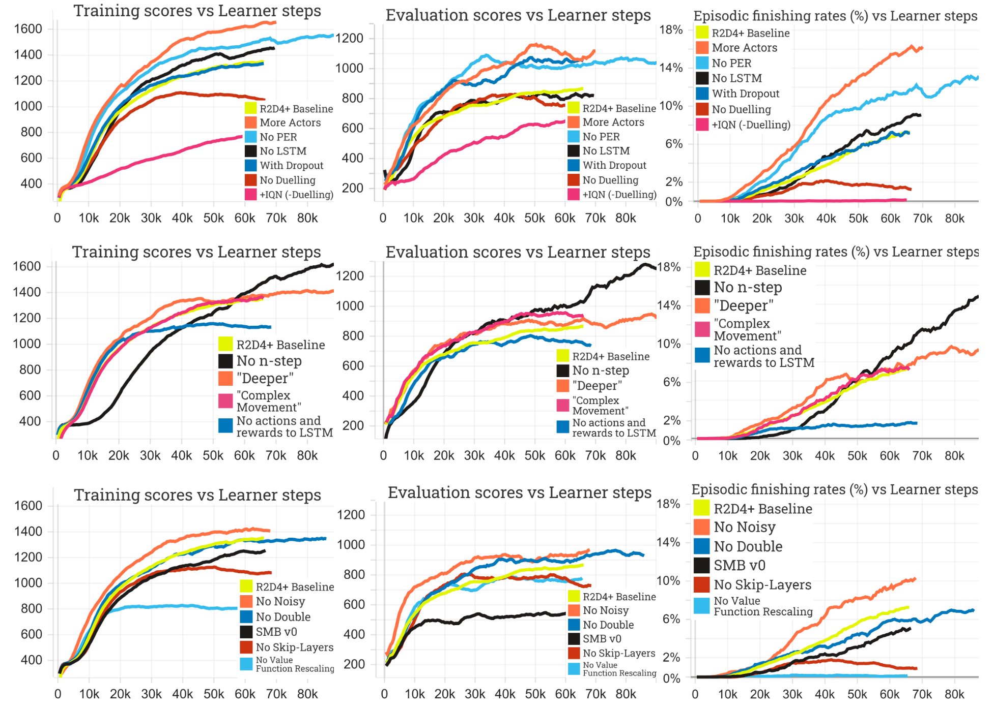
7.
Demonstrating the knowledge and understanding gained:

Slide 62
Conclusion
The aim of this project was to investigate how best to apply and combine recent advances in Reinforcement Learning to create an intelligent agent able to learn to play Super Mario Bros proficiently, given no additional expert information.
We name this agent R2D4+.
The project was a great success, with 6 of 7 deliverables being fully delivered upon.
Thanks for listening!
Notes:
To summarize, the aim of this project is to investigate how best to apply and combine recent advances in Reinforcement Learning to create an intelligent agent able to learn to play Super Mario Bros to a high level, given no additional expert information or feature engineering.
Thank you for listening!
Feel free to ask any questions you may have and i will do my best to answer them!

Slide 63
References
Heinz, S. (2019), ‘Using reinforcement learning to play super mario bros on nes using tensorflow’.URL:https://towardsdatascience.com/using-reinforcement-learning-to-play-super-mario-bros-on-nes-using-tensorflow-31281e35825
Klein, S. (2016), ‘Cs229 final report deep q-learning to play mario’.
Tsay, J.-J., Chen, C.-C. and Hsu, J.-J. (2011), Evolving intelligent mario controller by reinforcement learning,in‘2011 International Conference on Technologies and Applications of Artificial Intelligence’, IEEE, pp. 266–272.
Joshi, M., Khobragade, R., Sarda, S., Deshpande, U. and Mohan, S. (2012), Object-oriented representation and hierarchical reinforcement learning in infinite mario,in‘2012 IEEE 24th International Conference on Tools with Artificial Intelligence’, Vol. 1, IEEE, pp. 1076–1081.
Mohan, S. and Laird, J. (2010), Relational reinforcement learning in infinite mario, in ‘Proceedings of the AAAI Conference on Artificial Intelligence’, Vol. 24.
Du, Y., Cui, S. and Guo, S. (2009), ‘Applying machine learning in game ai design’.
Jørgensen, L. D. and Sandberg, T. W. (2009), ‘Playing mario using advanced ai techniques’,[online], IT University of Copenhagen , Available at : http://twsandberg.dk/media/4615/playing%20mario%20using%20advanced%20ai%20techniques.pdf.
Lee, G., Luo, M., Zambetta, F. and Li, X. (2014), Learning a super mario controller from examples of human play,in ‘2014 IEEE Congress on Evolutionary Computation (CEC)’, IEEE, pp. 1–8.
Lindberg, M. (2014), ‘An imitation-learning based agent playing super mario’.
Liao, Y., Yi, K. and Yang, Z. (2012), Cs229 final report reinforcement learning to play mario, Technical report, Technical report, Stanford University.
Togelius, J., Karakovskiy, S. and Baumgarten, R. (2010), The 2009 mario ai competition, in ‘IEEE Congress on Evolutionary Computation’, IEEE, pp. 1–8.
Togelius, J., Shaker, N., Karakovskiy, S. and Yannakakis, G. N. (2013), ‘The mario ai championship 2009-2012’,AI Magazine34(3), 89–92.

Slide 64
References
Mnih, V. et al. (2013), ‘Playing atari with deep reinforcement learning’,arXiv preprint arXiv:1312.5602.
van Hasselt, H. (2010), ‘Double q-learning’, Advances in neural information processing systems23, 2613–2621.
van Hasselt, H., Guez, A. and Silver, D. (2015), ‘Deep reinforcement learning with double q-learning’.
Lin, L.-J. (1993), Reinforcement learning for robots using neural networks, Technical report, Carnegie-Mellon Univ Pittsburgh PA School of Computer Science.
Wang, Z. et al. (2016), ‘Dueling network architectures for deep reinforcement learning’.
Schaul, T., Quan, J., Antonoglou, I. and Silver, D. (2016), ‘Prioritized experience replay’.
Horgan, D. et al. (2018), ‘Distributed prioritized experience replay’.
Pohlen, T. et al. (2018), ‘Observe and look further: Achieving consistent performance on atari’.
Kapturowski, S., Ostrovski, G., Dabney, W., Quan, J. and Munos, R. (2019), Recurrent experience replay in dis-tributed reinforcement learning, in ‘International Conference on Learning Representations’.
Fortunato, M. et al. (2017), ‘Noisy networks for exploration’, arXiv preprint arXiv:1706.10295.
Sutton, R. S. (1988), ‘Learning to predict by the methods of temporal differences’, Machine learning3(1), 9–44.
Bellemare, M. G., Dabney, W. and Munos, R. (2017), A distributional perspective on reinforcement learning, in ‘International Conference on Machine Learning’, PMLR, pp. 449–458.
Dabney, W., Rowland, M., Bellemare, M. and Munos, R. (2018), Distributional reinforcement learning with quantile regression, in ‘Proceedings of the AAAI Conference on Artificial Intelligence’, Vol. 32.
Dabney, W., Ostrovski, G., Silver, D. and Munos, R. (2018), Implicit quantile networks for distributional reinforcement learning, in ‘International conference on machine learning’, PMLR, pp. 1096–1105.
Sinha, S., Bharadhwaj, H., Srinivas, A. and Garg, A. (2020), ‘D2rl: Deep dense architectures in reinforcement learning’.
Hessel, M. et al. (2017), ‘Rainbow: Combining improvements in deep reinforcement learning’.
Watkins, C. J. and Dayan, P. (1992), ‘Q-learning’, Machine learning8(3-4), 279–292.

Slide 65
References
Kauten, C. (2018), ‘Super Mario Bros for OpenAI Gym’, GitHub.URL:https://github.com/Kautenja/gym-super-mario-bros

Slide 66
Our Planned Solution: Recurrent Replay Deeper Denser Distributed DQN+
Double Q (2010) [14]
Q Learning (1992) [29]
Replay Buffer (1993) [16]
DQN (2013) [13]
Ape-X (2018) [19]
PER (2016) [18]
n-step Returns(1988) [23]
Noisy Nets (2017) [22]
Dueling DDQN (2016) [17]
DDQN (2015) [15]
C51 (2017) [24]
QR-DQN (2018) [25]
Observe (2018) [20]
R2D2 (2018) [21]
Rainbow (2017) [28]
D2RL (2020) [27]
IQN (2018) [26]
R2D4+ (Our Planned Solution)
Notes:
R2D4+ stands for Recurrent Replay Deeper Denser Distributed DQN+ The dashed line here represents an inheritance that does not flow all the way to our solution, as instead of deciding to make our solution distributional using C51 as Rainbow does, we decided to instead use the much improved IQN algorithm.

